Slide 1
Tricks of the Trade
Shortcuts for Statophobes

Slide 2
Inter-disciplicary Strategy
Ramayan
Shravan Kumar episode
Lanka War
DDLJ
Europe trip and Drinking Incident
Train catching scene
Interval Estimation
Where does χ² come from?
Bad shots (like poor grades) have inter-generational effect
If she can survive Europe with you, marry her
Theory helps!

Slide 3
Lessons from Cooking
You can cook kheer only if you have sugar

Slide 4
Example 1
A student organization uses the proceeds from a particular soft-drink dispensing machine to finance its activities.
The price per can had been Rs. 30 for a long time, and the average daily revenue during that period had been Rs. 3000.
The price was recently increased to Rs. 40 per can.
A random sample of n = 20 days after the price increase yielded a sample mean daily revenue and sample standard deviation of Rs. 2800 and Rs. 180, respectively.
Assume daily revenue is normally distributed.
Construct a confidence interval using α = .05.
Does this information suggest that the true average daily revenue has decreased from its value before the price increase?

Slide 5
Example 2
An automobile manufacturer who wishes to advertise that one of its models achieves 30 kmpl (km per litre) decides to carry out a fuel efficiency test.
Six nonprofessional drivers are selected, and each one drives a car from Delhi to Sonepat.
The resulting fuel efficiencies (in kmpl) are: 27.2, 29.3, 31.2, 28.4, 30.3, 29.6.
Assuming that fuel efficiency is normally distributed under these circumstances, do the data contradict the claim that true average fuel efficiency is 30 kmpl?

Slide 6
Example 3
An economist collects a sample of 200 road accidents in which teenagers were involved and records whether the teenager was under the influence of alcohol during the accident. The data is shown in Sheet 2, Excel File.
Create a 95% confidence interval for the percentage of road accidents that involve teenage drivers.
Does the sample suggest that drunk teenage accidents are more prevalent in Karnataka than in Haryana? State your assumptions clearly.
The legal drinking age in Haryana is 25 while that of Karnataka is 18. Does your previous answer offer argument in favor of changing the norms of legal drinking age?

Slide 7
Example 4
If X₁, X₂, … , X_{n} constitute a random sample from a normal population with μ = 0, show that
$$\sum_{i=1}^{n}{\frac{X_{i}^{2}}{n}}$$
is a unbiased estimator of σ²

Slide 8
Example 5
Given a random sample of size n from a uniform population with α = 0, find the estimator for β by the method of moments.

Slide 9
Example 6
If X₁, X₂, … , X_{n} constitute a random sample of size n from population given by
$$g\left(x;θ,δ\right)=\left\{\begin{aligned}\frac{1}{θ}∙e^{−\frac{x−1}{θ}} \\ 0\end{aligned}\begin{aligned} \\ \end{aligned}\begin{aligned} \\ \end{aligned}\begin{aligned} \\ \end{aligned}\begin{aligned} \\ \end{aligned}\begin{aligned}for x>1 \\ elsewhere\end{aligned}\right.$$
Find estimators for θ by using method of maximum likelihood.

Slide 10
Example 6 - Solution
Joint pdf of (X₁, X₂, … , X_{n}) is
$$f\left(X_{1}\text{, }X_{2}\text{,}\text{ … ,}X_{n}\right) \text{=}\left(\frac{1}{θ}∙e^{−\frac{x_{1}−1}{θ}}\right)\left(\frac{1}{θ}∙e^{−\frac{x_{2}−1}{θ}}\right)…\left(\frac{1}{θ}∙e^{−\frac{x_{n}−1}{θ}}\right)=\frac{1}{θ^{n}}∙e^{−\frac{\sum_{i=1}^{n}{x_{i}}−n}{θ}}$$
We maximize f(..) with respect to θ.
$$\begin{matrix}\frac{df}{dθ} & = & −\frac{n}{θ^{n+1}}∙e^{−\frac{\sum_{i=1}^{n}{x_{i}}−n}{θ}}+\frac{1}{θ^{n}}∙e^{−\frac{\sum_{i=1}^{n}{x_{i}}−n}{θ}}\left(+\frac{\sum_{i=1}^{n}{x_{i}}−n}{θ^{2}}\right) \\ & = & \frac{1}{θ^{n+2}}∙e^{−\frac{\sum_{i=1}^{n}{x_{i}}−n}{θ}}\left[−nθ+\sum_{i=1}^{n}{x_{i}}−n\right] \\ \frac{df}{dθ}=0 & if & \left[−nθ+\sum_{i=1}^{n}{x_{i}}−n\right]=0 \text{or} θ=\frac{\sum_{i=1}^{n}{x_{i}}}{n}−1 \end{matrix}$$
Hence $\overline{x}−1$ is an estimator of θ.

Slide 11
Hypothesis Testing
Same idea, different angle

Slide 12
In brief
Interval Estimation
Hypothesis Testing
You collect sample(s)
Make a guess about the range of population parameters – lowest and highest values
μ ε [μ_{L}, μ_{H}]. What are μ_{L} and μ_{H}?
μ₁ – μ₂ ε [a, b]. What are a and b?
Talk about range of μ
You collect sample(s)
You want make (more) precise statements about the parameter values
Can μ > 50?
Is μ₁ > μ₂?
Talk about probabilities of certain μ

Slide 13
Statistical Hypothesis - I
An assertion or conjecture
About distribution on one or more random variables
If your hypothesis completely specifies the distribution, then it is simple hypothesis..
If not, composite hypothesis

Slide 14
Statistical Hypothesis - II
Importance of alternative hypothesis
X ≈ N(μ, 1). Sample.
H₀: μ = 50, H_{A}: μ ≠ 50
X ≈ N(μ, 1). Sample.
H₀: μ > 50, H_{A}: μ ≤ 50

Slide 15
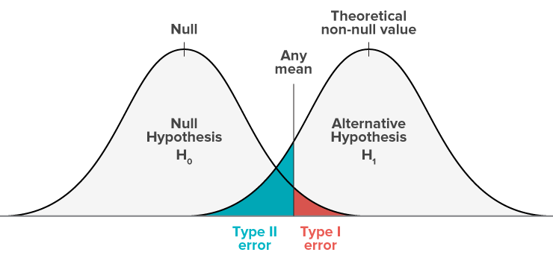
Errors Possible
X ≈ N(μ, 1). Sample.
H₀: μ = 50, H_{A}: μ = 60

Slide 16
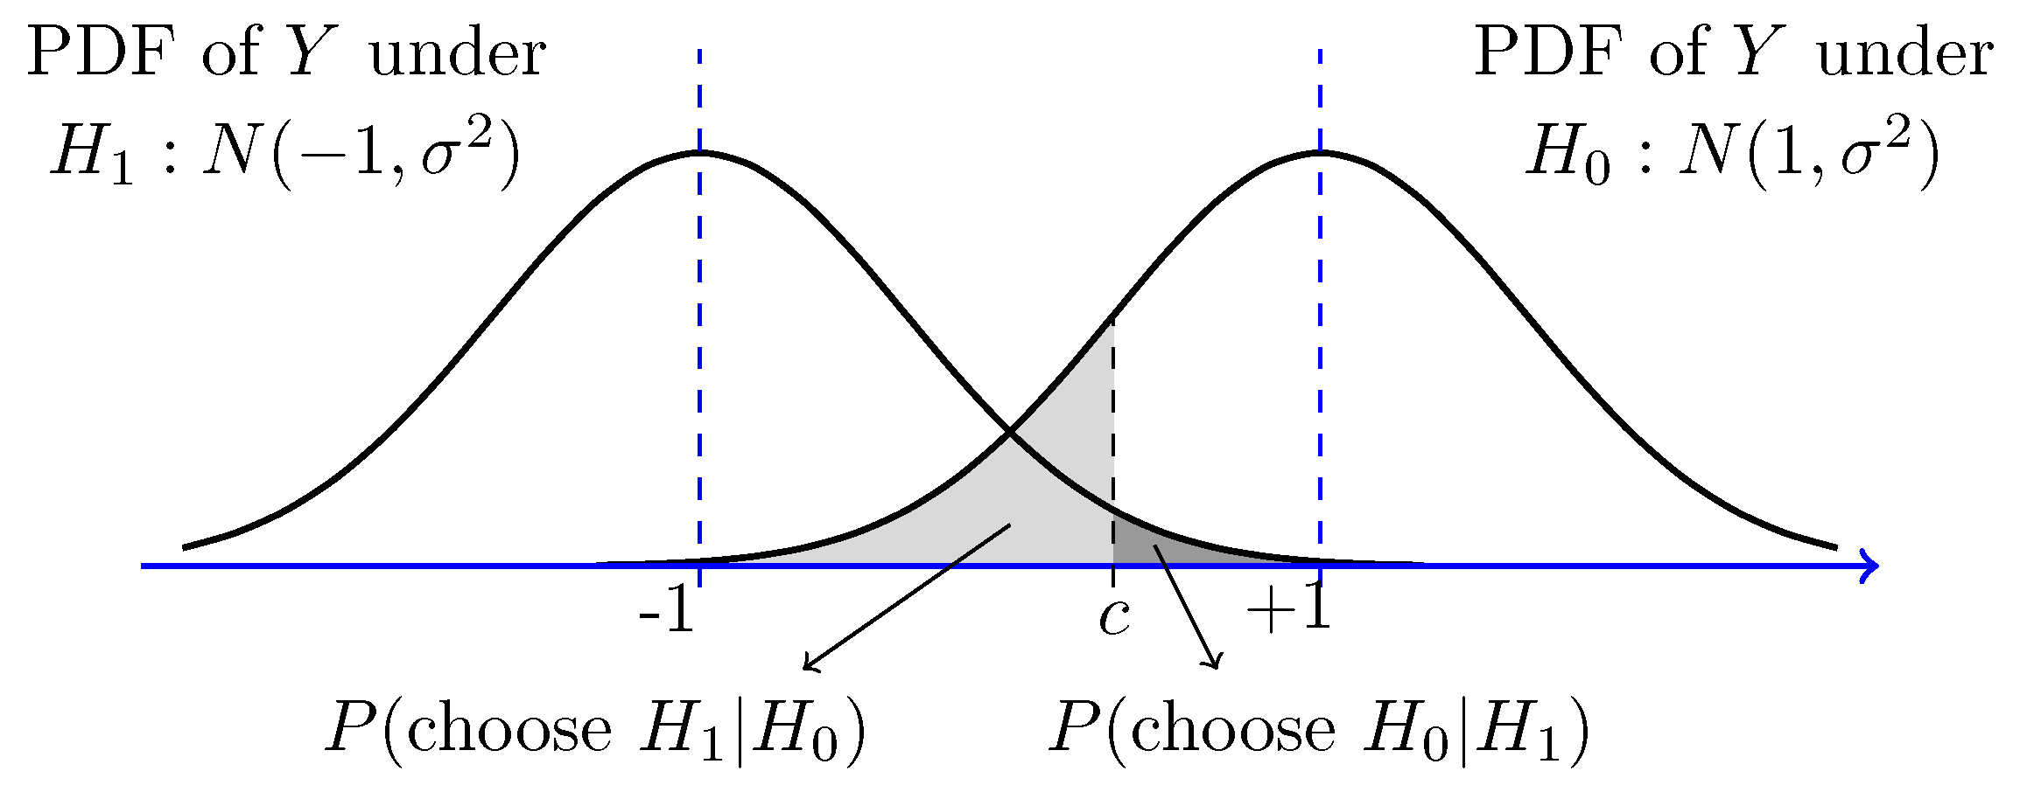
To be more precise, this is what we mean by α and β

Slide 17
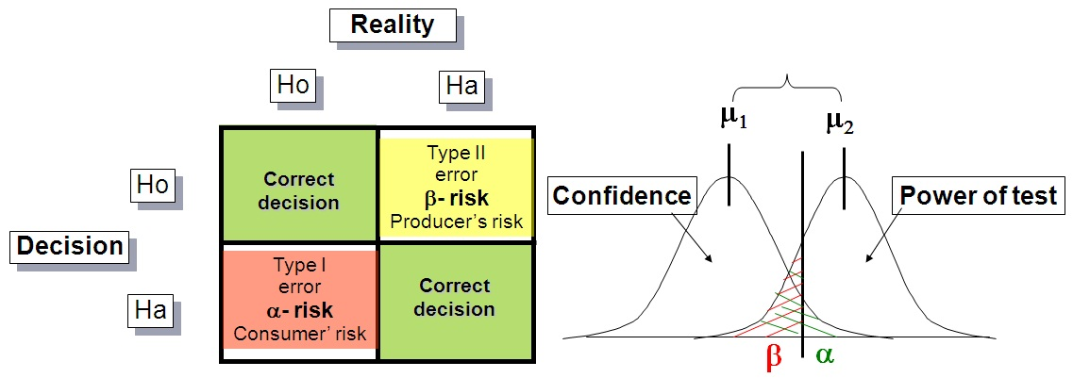
Central Idea
Probability of Type I Error?
Probability of Type II Error?
Which is in your control or smaller?

