Slide 1

Constrained optimization
Chapter 14

Slide 2
What is constrained optimization?
You want to maximize something within the purview of some restrictions
Examples,
  Maximize learning subject to time spent in studying Maths + time spent in studying other subjects = 5 hours
  Minimize monthly expenditure subject to expenditure give you a minimum level of happiness
  Max or Min f(x, y) subject to g(x, y) = c

Slide 3

Method 1
Maximize xy such that x + 3y = 24
You will do it like this:
f(y) = (24-3y)y
Choose y to minimize f(y)
$\frac{df}{dy}=24−6y$
$\frac{d^{2}f}{dy^{2}}=−6$
Stationary point at y = 4. It is a point of maximum. x = 12
But what if you have a more convoluted problem like this:
Maximize x + y subject to x² + 3xy + 3y² = 3

Slide 4
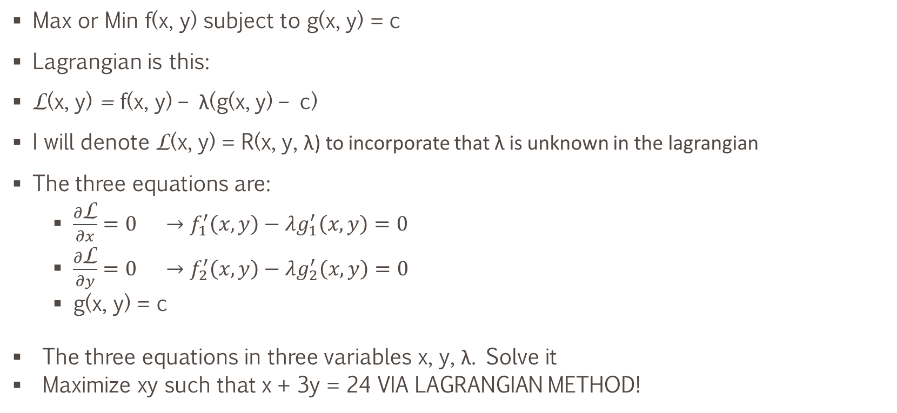
Method 2 – Lagrange Method
  Max or Min f(x, y) subject to g(x, y) = c
Lagrangian is this:
L(x, y) = f(x, y) – λ(g(x, y) – c)
I will denote L(x, y) = R(x, y, λ) to incorporate that λ is unknown in the lagrangian
The three equations are:
  $\frac{∂\text{L}}{∂x}={0 →f}_{1}^{′}\left(x, y\right)−λg_{1}^{′}\left(x, y\right)=0$
  $\frac{∂\text{L}}{∂y}={0 →f}_{2}^{′}\left(x, y\right)−λg_{2}^{′}\left(x, y\right)=0$
  g(x, y) = c
  The three equations in three variables x, y, λ. Solve it
  Maximize xy such that x + 3y = 24 VIA LAGRANGIAN METHOD!

Slide 5
Question
Consider the utility maximization problem
max xª + y subject to px + y = m
where all constants are positive, a ∈ (0, 1).
Find the demand functions, x∗(p, m) and y∗(p, m).
Find the partial derivatives of the demand functions w.r.t. p and m, and check their signs.
How does the optimal expenditure on the x good vary with p? (Check the elasticity of
px∗(p, m) w.r.t. p.)
Put a = 1/2. What are the demand functions in this case? Denote the maximal utility
as a function of p and m by U*(p, m), the value function, also called the indirect utility
function.
Verify that ∂U*/∂p = −x*(p, m).

Slide 6
Homework Problems
All problems in Section 14.2
Page 505

Slide 7
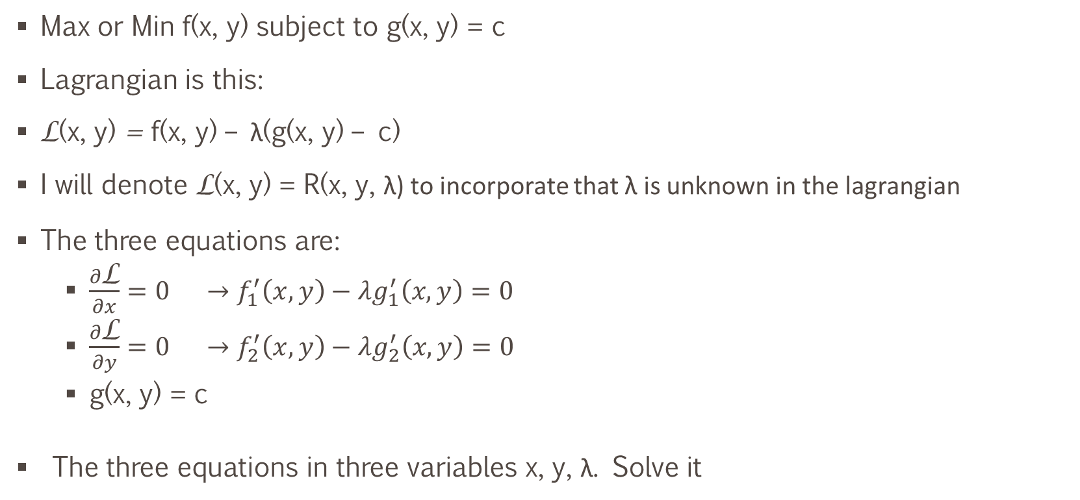
Lagrange Method – Necessary Conditions
  Max or Min f(x, y) subject to g(x, y) = c
Lagrangian is this:
L(x, y) = f(x, y) – λ(g(x, y) – c)
I will denote L(x, y) = R(x, y, λ) to incorporate that λ is unknown in the lagrangian
The three equations are:
  $\frac{∂\text{L}}{∂x}={0 →f}_{1}^{′}\left(x, y\right)−λg_{1}^{′}\left(x, y\right)=0$
  $\frac{∂\text{L}}{∂y}={0 →f}_{2}^{′}\left(x, y\right)−λg_{2}^{′}\left(x, y\right)=0$
  g(x, y) = c
  The three equations in three variables x, y, λ. Solve it

Slide 8
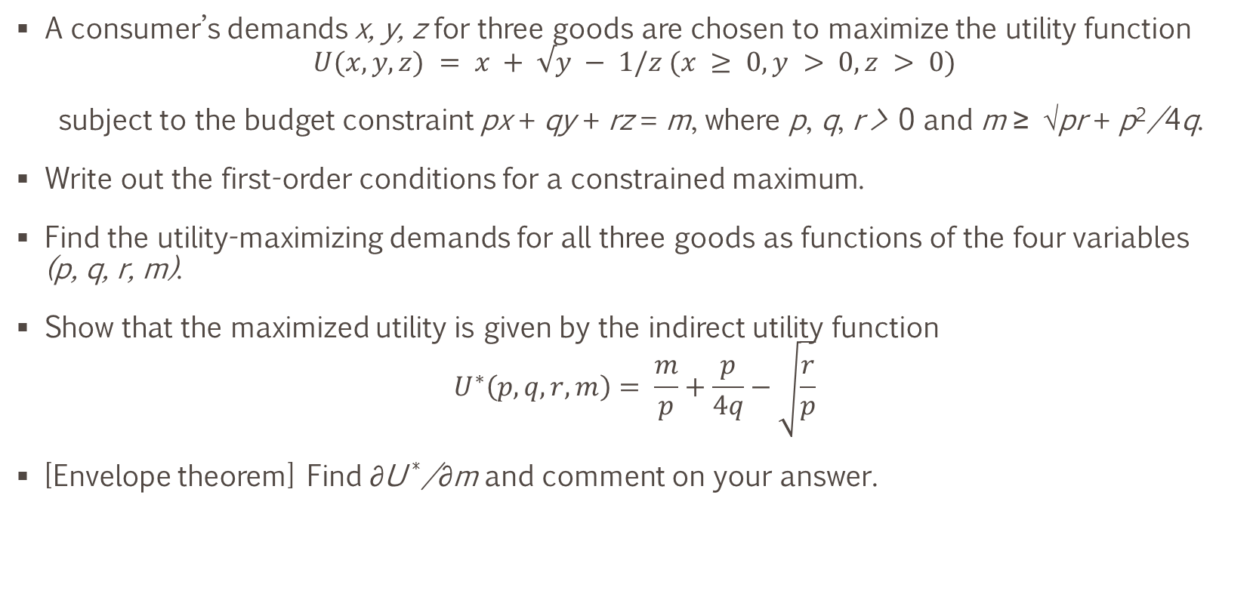
Question
A consumer’s demands x, y, z for three goods are chosen to maximize the utility function
$U(x, y, z) = x + √y − 1/z (x ≥ 0, y > 0, z > 0)$
subject to the budget constraint px + qy + rz = m, where p, q, r > 0 and m ≥ √pr + p²/4q.
Write out the first-order conditions for a constrained maximum.
Find the utility-maximizing demands for all three goods as functions of the four variables
(p, q, r, m).
Show that the maximized utility is given by the indirect utility function
$$U^{∗}\left(p, q, r, m\right)= \frac{m}{p}+\frac{p}{4q}−\sqrt{\frac{r}{p}}$$
[Envelope theorem] Find ∂U */∂m and comment on your answer.

Slide 9
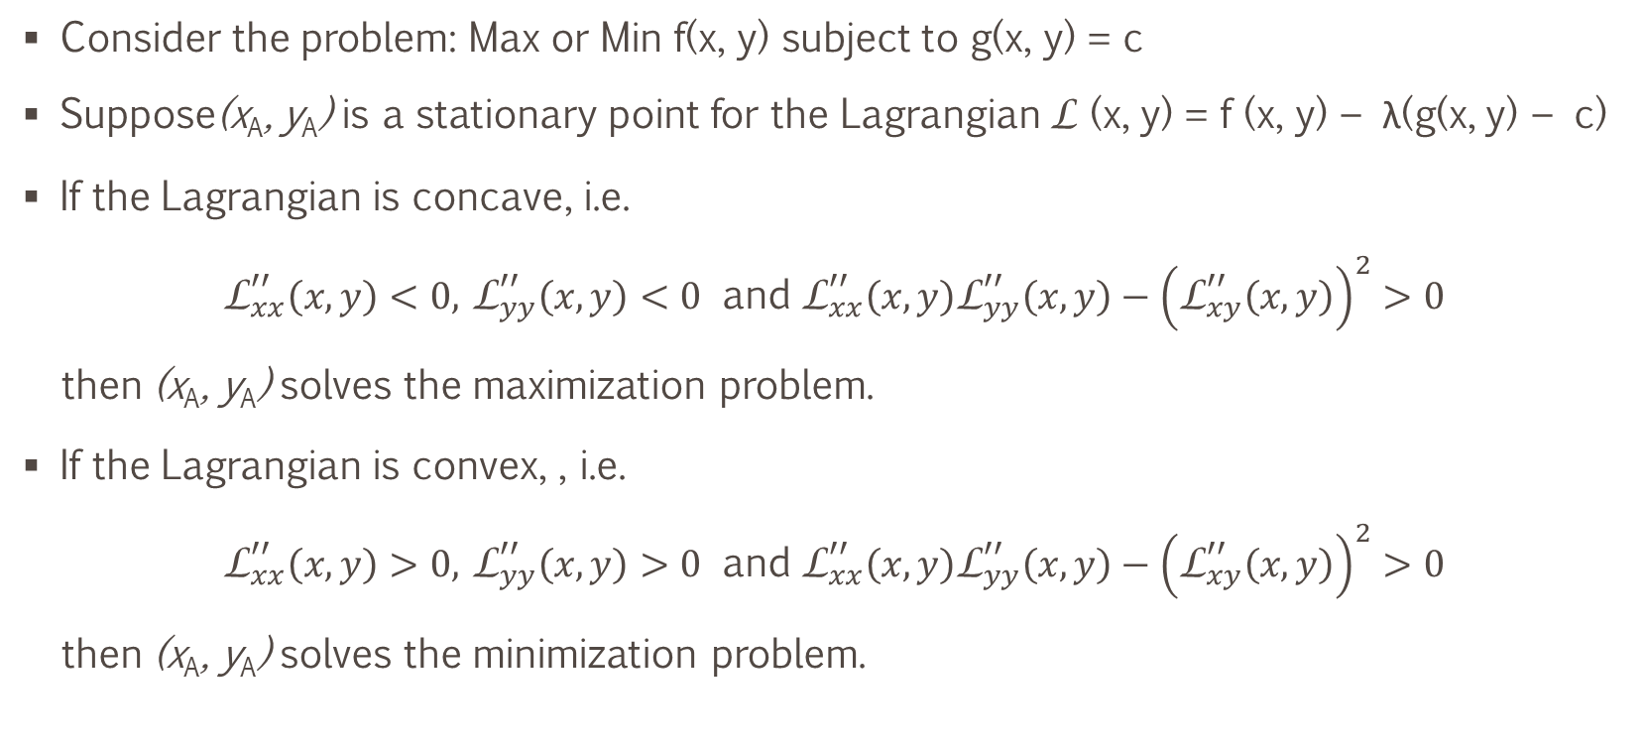
Constrained Optimization – Sufficient Conditions I
Consider the problem: Max or Min f(x, y) subject to g(x, y) = c
Suppose(x_{A}, y_{A}) is a stationary point for the Lagrangian L (x, y) = f (x, y) − λ(g(x, y) − c)
If the Lagrangian is concave, i.e.
${\text{L}}_{xx}^{′′}\left(x,y\right)<0,$ ${\text{L}}_{yy}^{′′}\left(x,y\right)<0$ and ${\text{L}}_{xx}^{′′}\left(x,y\right){\text{L}}_{yy}^{′′}\left(x,y\right)−{\left({\text{L}}_{xy}^{′′}\left(x,y\right)\right)}^{2}>0$
then (x_{A}, y_{A}) solves the maximization problem.
If the Lagrangian is convex, , i.e.
${\text{L}}_{xx}^{′′}\left(x,y\right)>0,$ ${\text{L}}_{yy}^{′′}\left(x,y\right)>0$ and ${\text{L}}_{xx}^{′′}\left(x,y\right){\text{L}}_{yy}^{′′}\left(x,y\right)−{\left({\text{L}}_{xy}^{′′}\left(x,y\right)\right)}^{2}>0$
then (x_{A}, y_{A}) solves the minimization problem.

Slide 10

Determinant of 3 Vector Matrix
$$Det\left[\begin{matrix}a_{11} & a_{12} & a_{13} \\ a_{21} & a_{22} & a_{23} \\ a_{31} & a_{32} & a_{33}\end{matrix}\right]=a_{11}\left|\begin{matrix}a_{22} & a_{23} \\ a_{32} & a_{33}\end{matrix}\right|−a_{12}\left|\begin{matrix}a_{21} & a_{23} \\ a_{31} & a_{33}\end{matrix}\right|+a_{13}\left|\begin{matrix}a_{21} & a_{22} \\ a_{31} & a_{32}\end{matrix}\right|$$
$Det\left[\begin{matrix}9 & 2 & 0 \\ 1 & 3 & 5 \\ 4 & 3 & 2\end{matrix}\right]=?$

Slide 11
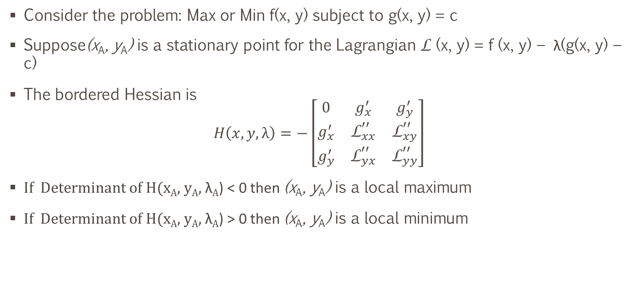
Constrained Optimization – Sufficient Conditions II
Consider the problem: Max or Min f(x, y) subject to g(x, y) = c
Suppose(x_{A}, y_{A}) is a stationary point for the Lagrangian L (x, y) = f (x, y) − λ(g(x, y) − c)
The bordered Hessian is
$$H\left(x, y, λ\right)=−\left[\begin{matrix}0 & g_{x}^{′} & g_{y}^{′} \\ g_{x}^{′} & {\text{L}}_{xx}^{′′} & {\text{L}}_{xy}^{′′} \\ g_{y}^{′} & {\text{L}}_{yx}^{′′} & {\text{L}}_{yy}^{′′}\end{matrix}\right]$$
If Determinant of H(x_{A}, y_{A}, λ_{A}) < 0 then (x_{A}, y_{A}) is a local maximum
If Determinant of H(x_{A}, y_{A}, λ_{A}) > 0 then (x_{A}, y_{A}) is a local minimum

Slide 12

Example
Optimize $x + a\ln{y}$ subject to $px+qy=m$
Is it max or min?

Slide 13

Envelope Theorem
Using vector notation with x = (x₁, . . . , x_{n}) and r = (r₁, . . . , r_{k}), consider the version
max(min)_{x} f (x, r) subject to g_{j}(x, r) = 0
$f^{∗}(x^{∗}\left(r\right),r)$ is optimal value function
$\frac{∂f^{∗}(r_{i})}{∂r_{i}}={{\left[\frac{∂\text{L}(x,r)}{∂r_{i}}\right]}_{x=x^{∗}(r)}}_{i}$
For max(min)_{x} f (x, r) subject to g_{i}(x, r) = c_{i}
$\frac{∂f^{∗}(c_{i})}{∂c_{i}}=λ_{i}(c_{i})$

Slide 14
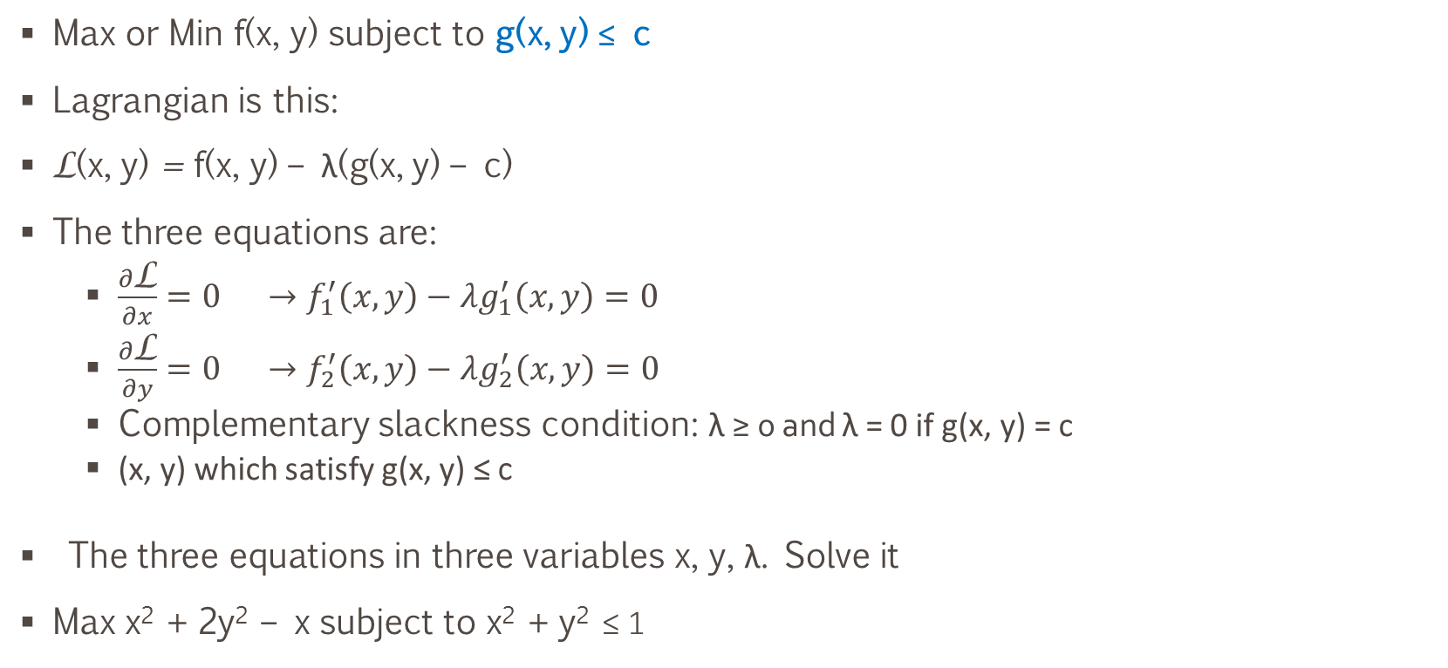
With inequality constraints
  Max or Min f(x, y) subject to g(x, y) ≤ c
Lagrangian is this:
L(x, y) = f(x, y) – λ(g(x, y) – c)
The three equations are:
  $\frac{∂\text{L}}{∂x}={0 →f}_{1}^{′}\left(x, y\right)−λg_{1}^{′}\left(x, y\right)=0$
  $\frac{∂\text{L}}{∂y}={0 →f}_{2}^{′}\left(x, y\right)−λg_{2}^{′}\left(x, y\right)=0$
  Complementary slackness condition: λ ≥ 0 and λ = 0 if g(x, y) = c
  (x, y) which satisfy g(x, y) ≤ c
  The three equations in three variables x, y, λ. Solve it
Max x² + 2y² – x subject to x² + y² ≤ 1

Slide 15

Question
$\max{ \left(x^{2}+2y^{2}−x\right)} subject to x^{2}+y^{2}≤a$

Slide 16

Question
Sketch the admissible set S for the problem
$$\max\left(x+ y − e^{x} − e^{x+y}\right) subject to x + y ≥ 4, x ≥ −1, y ≥ 1$$
Find all pairs (x, y) that satisfy all the necessary conditions. Find the solution to the problem

Slide 17

Question
Sketch the admissible set for the problem
$\max{−{\left(x +0.5\right)}^{2}}−0.5y^{2} subject to e^{−x} − y ≤ 0 and y ≤ \frac{2}{3}$
Write down the Kuhn–Tucker conditions, and find the solution of the problem

Slide 18
Good Problems
Page 541 of the book

