Slide 1
Shivangi’s Questions
z = x³+ 3x²y + 7y +9
What is $\frac{∂x}{∂y}$?
What is $\frac{dx}{dy}$?
What is dz?
$\frac{u}{v}=\text{x}\text{3}\text{+ 3}\text{x}\text{2}\text{y}\text{ + 7}\text{y}\text{ +9}$
What is $\frac{∂{(u}/{v)}}{∂y}$?

Slide 2
Multivariable Optimization
Chapter 13

Slide 3
Function of one variable
Suppose y = f(x)
What are the necessary conditions for an interior extreme point?
What is the additional condition needed?

Slide 4
Example 3, Page 288. Good one.
x = 0 has zero curvature, but its is not an inflection point

Slide 5
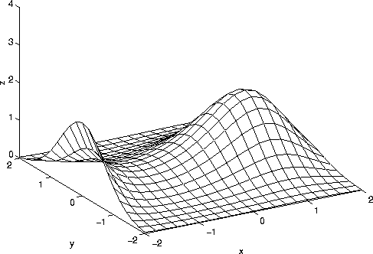
Function of two variables

Slide 6
Function of two variables
Consider a differentiable function z = f(x, y) defined over a set S in the xy plane
Suppose f attains its maximum at an interior point (x₀, y₀) of S
f(x₀, y₀) ≥ f(x, y) for all (x, y) in S
f(x₀, y₀) ≥ f(x, y₀) for all (x, y₀) in S
g(x) = f(x, y₀) has its maximum at x = x₀
g’(x) = 0 at x = x₀
$\frac{∂f}{∂x}=0$ at (x_{o}, y_{o})
By similar logic, $\frac{∂f}{∂y}=0$ at (x_{o}, y_{o})

Slide 7
Function of two variables: necessary conditions
A differentiable function z = f(x, y) can have a maximum or a minimum at an interior point (x₀, y₀) of S only if it is a stationary point, that is
$\frac{∂f}{∂x}=o$, $\frac{∂f}{∂y}=o$ at (x_{o}, y_{o})

Slide 8
Question 1
What is the stationary point for the following function?
$$f\left(x_{1}, x_{2}\right)=−\frac{1}{8}x_{1}^{2}−\frac{1}{8}x_{2}^{2}−\frac{1}{2}x_{1}+\frac{1}{2}x_{1}x_{2}+x_{2}+10$$

Slide 9
Question 2
A firm produces two different kinds A and B of a commodity. The daily cost of producing x units of A and y units of B is $C\left(x, y\right)= 2x^{2}−4xy + 4y^{2}− 40x − 20y + 514$ Suppose that the firm sells all its output at a price per unit of $24 for A and $12 for B.
What is the profit function?
What is the necessary condition for maximum profit?

Slide 10
Maxima and Minima

Slide 11
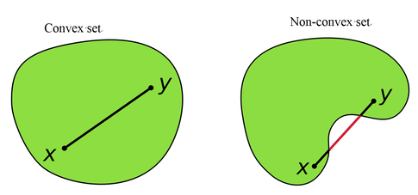
Convex Sets
A convex set is a set of points such that, given any two points x, y in that set, the line xy joining them lies entirely within that set.
Intuitively, this means that the set is connected (so that you can pass between any two points without leaving the set) and has no dents in its perimeter.

Slide 12
Determinant of a Matrix
If a 2 by 2 matrix is this $\left[\begin{matrix}a & b \\ c & d\end{matrix}\right]$
The determinant of the matrix is denoted as
$$\left|\begin{matrix}a & b \\ c & d\end{matrix}\right|=ad−cb$$
What is the determinant $\left|\begin{matrix}10 & 7 \\ 3 & −8\end{matrix} \right|$

Slide 13
Global maximum – Sufficient Condition
Suppose (x₀, y₀) is an interior stationary point for a twice continuously differentiable function (C²) function f(x, y) defined in a convex set S in R²
If for all (x, y) in S,
$$f_{11}^{′′}\left(x,y\right)≤0, f_{22}^{′′}\left(x,y\right)≤0, \left|\begin{matrix}f_{11}^{′′}\left(x,y\right) & f_{12}^{′′}\left(x,y\right) \\ f_{21}^{′′}\left(x,y\right) & f_{22}^{′′}\left(x,y\right)\end{matrix}\right|≥0$$
then (x₀, y₀) is a maximum for f(x, y) in S.

Slide 14
Question 2b
In the previous question, does maximum profit exist?
A firm produces two different kinds A and B of a commodity. The daily cost of producing x units of A and y units of B is $C\left(x, y\right)= 2x^{2}−4xy + 4y^{2}− 40x − 20y + 514$ Suppose that the firm sells all its output at a price per unit of $24 for A and $12 for B.
What are the levels of x and y?
What is the maximum profit?

Slide 15
Global minimum – Sufficient Condition
Suppose (x₀, y₀) is an interior stationary point for a twice continuously differentiable function (C²) function f(x, y) defined in a convex set S in R²
If for all (x, y) in S,
$$f_{11}^{′′}\left(x,y\right)≥0, f_{22}^{′′}\left(x,y\right)≥0, \left|\begin{matrix}f_{11}^{′′}\left(x,y\right) & f_{12}^{′′}\left(x,y\right) \\ f_{21}^{′′}\left(x,y\right) & f_{22}^{′′}\left(x,y\right)\end{matrix}\right|≥0$$
then (x₀, y₀) is a minimum for f(x, y) in S.

Slide 16
Question 3
A function f of two variables is given by
f(x, y) = 5x² − 2xy + 2y² − 4x − 10y + 5 for all x and y.
What is the extreme point?
Is it a global max or global min or neither?

Slide 17
Local extrema
Suppose (x₀, y₀) is an interior stationary point for a twice continuously differentiable function (C²) function f(x, y) defined in a convex set S in R²
If for all (x, y) in S,
$$f_{11}^{′′}\left(x_{0},y_{0}\right)<0, \left|\begin{matrix}f_{11}^{′′}\left(x_{0},y_{0}\right) & f_{12}^{′′}\left(x_{0},y_{0}\right) \\ f_{21}^{′′}\left(x_{0},y_{0}\right) & f_{22}^{′′}\left(x_{0},y_{0}\right)\end{matrix}\right|>0$$
then (x₀, y₀) is a local maximum for f(x, y) in S.
If for all (x, y) in S,
$$f_{11}^{′′}\left(x_{0},y_{0}\right)>0, \left|\begin{matrix}f_{11}^{′′}\left(x_{0},y_{0}\right) & f_{12}^{′′}\left(x_{0},y_{0}\right) \\ f_{21}^{′′}\left(x_{0},y_{0}\right) & f_{22}^{′′}\left(x_{0},y_{0}\right)\end{matrix}\right|>0$$
then (x₀, y₀) is a local minimum for f(x, y) in S.

Slide 18
Saddle Point – Sufficient Condition
Suppose (x₀, y₀) is an interior stationary point for a twice continuously differentiable function (C²) function f(x, y) defined in a convex set S in R²
If for all (x, y) in S,
$$\left|\begin{matrix}f_{11}^{′′}\left(x_{0},y_{0}\right) & f_{12}^{′′}\left(x_{0},y_{0}\right) \\ f_{21}^{′′}\left(x_{0},y_{0}\right) & f_{22}^{′′}\left(x_{0},y_{0}\right)\end{matrix}\right|<0$$
then (x₀, y₀) is a saddle point

Slide 19
Anything is possible
Suppose (x₀, y₀) is an interior stationary point for a twice continuously differentiable function (C²) function f(x, y) defined in a convex set S in R²
If for all (x, y) in S,
$$\left|\begin{matrix}f_{11}^{′′}\left(x_{0},y_{0}\right) & f_{12}^{′′}\left(x_{0},y_{0}\right) \\ f_{21}^{′′}\left(x_{0},y_{0}\right) & f_{22}^{′′}\left(x_{0},y_{0}\right)\end{matrix}\right|=0$$
then (x₀, y₀) could be a local maximum, a local minimum or a saddle point

Slide 20
Question 4
Let f be a function of two variables, given by f (x, y) = (x² − axy)e^{y} where a ≠ 0 is a constant.
Sidenote: e^{y} → 0 at y → -∞. Deva: See this
Find the stationary points of f
Decide for each of them if it is a local maximum point, a local minimum point or a saddle point.

Slide 21
Question 5
A firm produces and sells a product in two separate markets. When the price in market A is p per ton, and the price in market B is q per ton, the demand in tons per week in the two markets are, respectively,
Q_{A} = a − bp, Q_{B} = c − dq
The cost function is C(Q_{A}, Q_{B}) = α + β(Q_{A} + Q_{B}), and all constants are positive.
Find the firm’s profit π as a function of the prices p and q, and then find the pair (p∗, q∗) that maximizes profits.
Suppose it becomes unlawful to discriminate by price, so that the firm must charge the same price in the two markets. What price p will now maximize profits?
In the case β = 0, find the firm’s loss of profit if it has to charge the same price in both markets. Comment.

Slide 22
Homework Problem
Questions 4 and 5 page 481 from the book

Slide 23
Problem with n-variables
The following function has a minimum point. Find it.
f (x, y, z) = 3 − x² − 2y² − 3z² − 2xy − 2xz

Slide 24
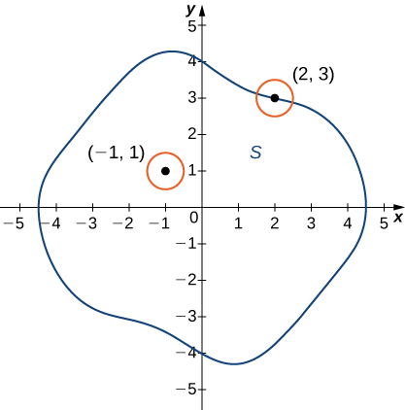
Extreme point
z₁
z₂
Ranking of z values possible
=>
Max and Min exist

Slide 25
Extreme Value Theorem – for your knowledge only
Suppose
f(x, y) is continuous throughout
a non-empty set S,
closed set S and
bounded set S in the plane
Then
there exists a point (a, b) in S where f has a minimum and a point (c, d) in S where f has a maximum
$$f\left(a,b\right)≤f\left(x,y\right)≤f\left(c,d\right) ∀ \left(x, y\right)∈S$$

Slide 26
Useful Result
Suppose f (x) = f (x₁, . . . , x_{n}) is defined over a set S in R^{n}, let F be a function of one variable defined over the range of f , and let c be a point in S. Define g over S by g(x) = F(f (x)). Then:
If F is increasing and c maximizes (minimizes) f over S, then c also maximizes (minimizes) g over S.
[Max of $e^{x^{2} +2xy^{2} − y^{2}}$] has the same solutions for x and y as the [max of $x^{2} +2xy^{2} − y^{2}$]
If F is strictly increasing, then c maximizes (minimizes) f over S if and only if c maximizes (minimizes) g over S

Slide 27
Envelope Theorem
Consider a function f(x, r)
Maximize or Minimize the function with respect to x
$\frac{∂f}{∂x}=0 →x=x^{∗}(r)$
The value function $f^{∗}\left(r\right)=f(x^{∗}\left(r\right), r)$
Then $\frac{∂f^{∗}\left(r\right)}{∂r}=f_{2}^{′}(x^{∗}\left(r\right), r)$

Slide 28
Question 7 – Microeconomics 4th Class
A firm uses capital K, labour L, and land T to produce Q units of a commodity, where Q = K^{2/3} + L^{1/2} + T ^{1/3}
Suppose that the firm is paid a positive price p for each unit it produces, and that the positive prices it pays per unit of capital, labour, and land are r, w, and q, respectively.
Express the firm’s profits as a function π of (K, L, T )
Find the values of K, L, and T (as functions of the four prices) that maximize the firm’s profits (assuming a maximum exists).
Let Q∗ denote the optimal number of units produced and K∗ the optimal capital stock. Show that ∂Q∗/∂r = −∂K∗/∂p.

