Slide 1
What are we doing so far?
Functions of one or more variables.
EMI payments depend on price of good, time of repayment and interest rate. EMI = f(P, t, i)
Learning depends on how many classes you attend, number of problems practise per week. L = f(At, Pr)
Probability that I will be allowed to go on a trip depended on marks, friends, costs involved. Prob = f(M, F, C)

Slide 2
Comparative Statics
Chapter 12

Slide 3

Rule 1: Simple Chain Rule
Suppose z = f(x, y) where both x(t) and y(t).
Hence z = f(x(t), y(t))
Then $\frac{dz}{dt}=\frac{∂f}{∂x}\frac{dx}{dt}+\frac{∂f}{∂y}\frac{dy}{dt}$

Slide 4

Q1
Production function of a good is $Y =10KL−\sqrt{K}−\sqrt{L}$
Suppose $K=0.2t+5$ and $L={5e}^{0.1t}$
What is the relative rate of growth of Y, i.e. what is $\dot{Y}/Y$?

Slide 5

Q2
A manufacturer determines that m employees will produce a total of q units of a product per day, where
$$q = \frac{10m^{2}}{\sqrt{m^{2}+19}}$$
If the demand equation for the product is p = 900/(q+9), determine the marginal-revenue when m = 9.

Slide 6

Rule 2: Chain rule for many variables
Suppose z = f(x, y) where both x(t, s) and y(t, s).
Hence z = f(x(t, s), y(t, s))
Then $\frac{∂z}{∂t}=\frac{∂f}{∂x}\frac{∂x}{∂t}+\frac{∂f}{∂y}\frac{∂y}{∂t}$ and $\frac{∂z}{∂s}=\frac{∂f}{∂x}\frac{∂x}{∂s}+\frac{∂f}{∂y}\frac{∂y}{∂s}$
The general rule is stated on page 418 of the book.

Slide 7
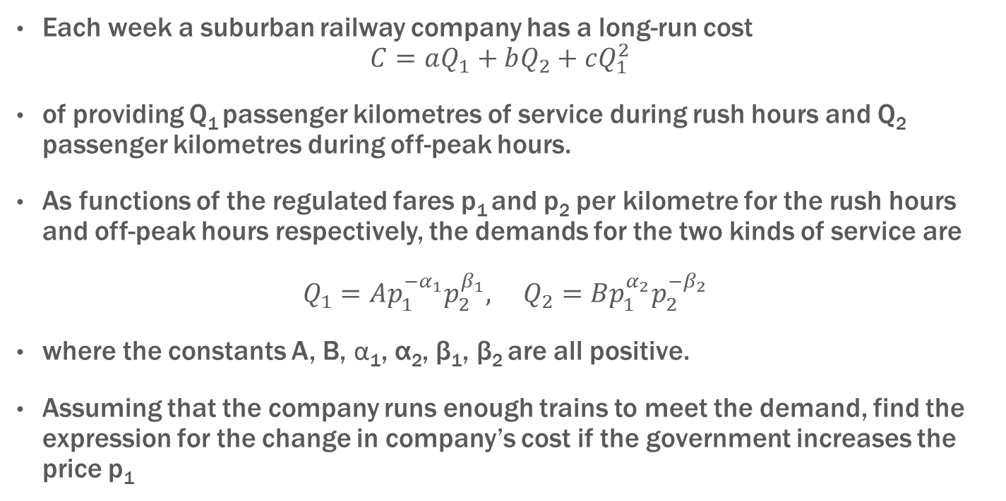
Q3
Each week a suburban railway company has a long-run cost
$$C=aQ_{1}+bQ_{2}+cQ_{1}^{2}$$
of providing Q₁ passenger kilometres of service during rush hours and Q₂ passenger kilometres during off-peak hours.
As functions of the regulated fares p₁ and p₂ per kilometre for the rush hours and off-peak hours respectively, the demands for the two kinds of service are
$Q_{1}=Ap_{1}^{−α_{1}}p_{2}^{β_{1}}, Q_{2}=Bp_{1}^{α_{2}}p_{2}^{−β_{2}}$
where the constants A, B, α₁, α₂, β₁, β₂ are all positive.
Assuming that the company runs enough trains to meet the demand, find the expression for the change in company’s cost if the government increases the price p₁

Slide 8

Rule 3: Differentials
Consider a function z = f(x, y)
Differential of z is defined as
$$dz=\frac{∂f}{∂x}dx+\frac{∂f}{∂y}dy$$

Slide 9

Q4
Calculate the differential of the following
$$U=a_{1}u_{1}^{2}+…+a_{n}u_{n}^{2}$$
[HW Problem] Calculate dU expressed in terms of dx and dy where
$$Ue^{U}=x\sqrt{y}$$

Slide 10

Rule 4: Slope of a level curve
Consider a function z = f(x, y)
Along the level curve, z = c (constant)
Hence $dz=\frac{∂f}{∂x}dx+\frac{∂f}{∂y}dy=0$. Or
$$\frac{dy}{dx}=−\frac{{∂f}/{∂x}}{{∂f}/{∂y}}$$

Slide 11
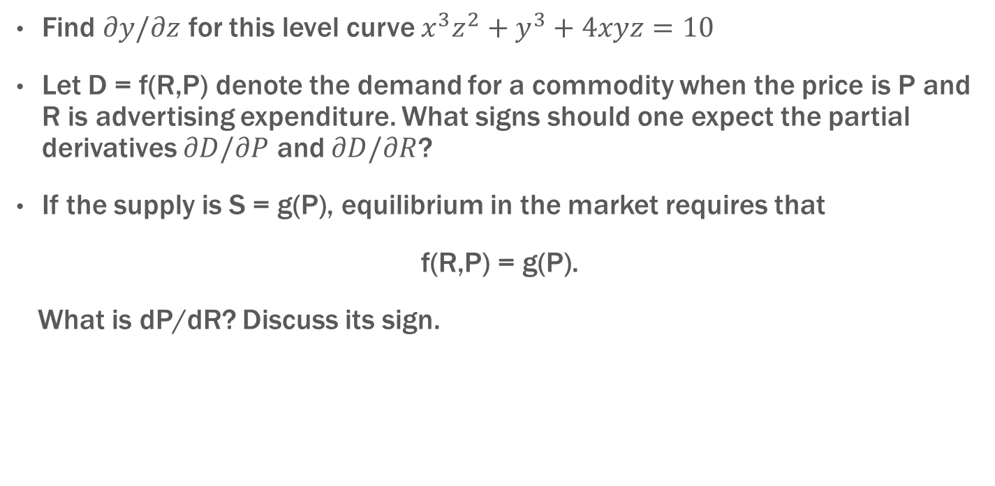
Q5
Find $∂y/∂z$ for this level curve $x^{3}z^{2}+y^{3}+4xyz=10$
Let D = f(R,P) denote the demand for a commodity when the price is P and R is advertising expenditure. What signs should one expect the partial derivatives $∂D/∂P$ and $∂D/∂R$?
If the supply is S = g(P), equilibrium in the market requires that
f(R,P) = g(P).
What is dP/dR? Discuss its sign.

Slide 12
Intuitive Explanation for dP/dR > 0
An increase in R,
shifts demand curve to the right
Q
g(P)
2. The new equilibrium has higher P.
Hence dP/dR > 0
f(R₂, P), R₂ > R₁
f(R₁, P)
P

Slide 13

Q6
The function F is defined for all x and y by $F(x, y ) = xe^{y−3}+xy^{2}−2y$. Show that the point (1, 3) lies on the level curve F(x, y) = 4.
Find the equation for the tangent line to the curve at the point (1,3).

Slide 14
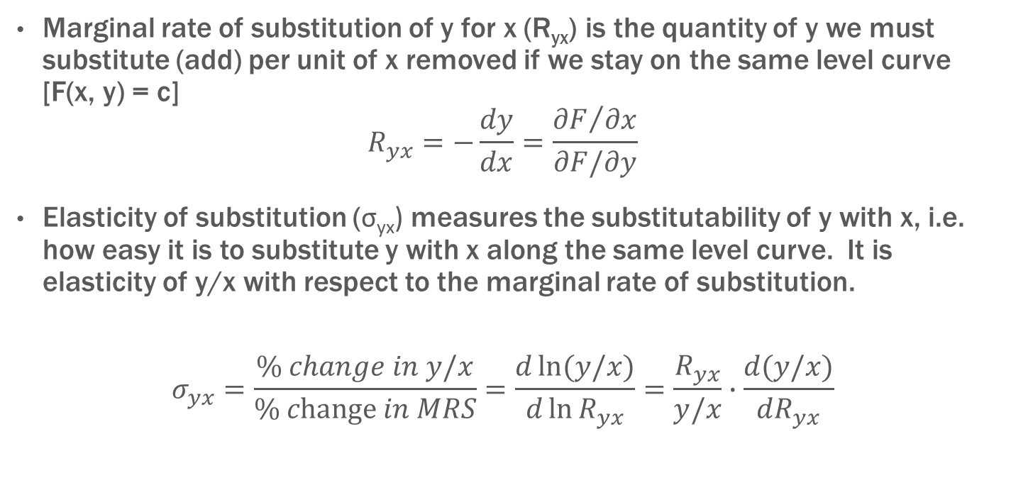
Rule 5: Elasticity of substitution
Marginal rate of substitution of y for x (R_{yx}) is the quantity of y we must substitute (add) per unit of x removed if we stay on the same level curve [F(x, y) = c]
$$R_{yx}=−\frac{dy}{dx}=\frac{{∂F}/{∂x}}{∂F/∂y}$$
Elasticity of substitution (σ_{yx}) measures the substitutability of y with x, i.e. how easy it is to substitute y with x along the same level curve. It is elasticity of y/x with respect to the marginal rate of substitution.
$$σ_{yx}=\frac{\% change in y/x}{\% change in MRS}=\frac{d\ln{(y/x})}{d\ln{R_{yx}}}=\frac{R_{yx}}{y/x}∙\frac{d(y/x)}{dR_{yx}}$$

Slide 15

Q7
Find the marginal rate of substitution of y for x in
$$F\left(x, y\right)= x^{a}+y^{a} (a≠0 and a≠1)$$
Calculate the elasticity of substitution between y and x

Slide 16
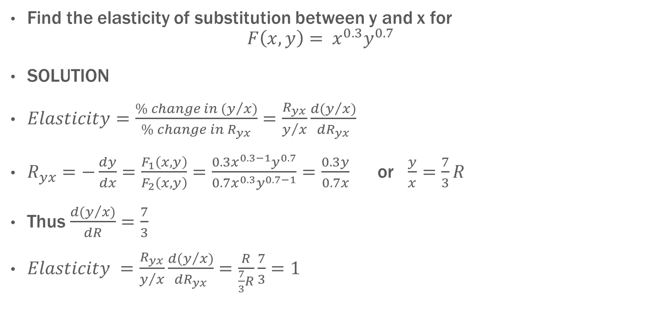
Question
Find the elasticity of substitution between y and x for
$$F\left(x, y\right)= x^{0.3}y^{0.7}$$
SOLUTION
$Elasticity=\frac{\% change in (y/x)}{\% change in R_{yx}}=\frac{R_{yx}}{y/x}\frac{d(y/x)}{{dR}_{yx}}$
$R_{yx}=−\frac{dy}{dx}=\frac{F_{1}\left(x, y\right)}{F_{2}\left(x, y\right)}=\frac{0.3x^{0.3−1}y^{0.7}}{0.7x^{0.3}y^{0.7−1}}=\frac{0.3y}{0.7x}$ or $\frac{y}{x}=\frac{7}{3}R$
Thus $\frac{d(y/{x)}}{dR}=\frac{7}{3}$
$Elasticity =\frac{R_{yx}}{y/x}\frac{d(y/x)}{{dR}_{yx}}=\frac{R}{\frac{7}{3}R}\frac{7}{3}=1$

Slide 17
Status so far
Good News
We have discussed all rules of differentiation – univariate and multivariate functions
Bad News
We will practise those rules…. in increasingly more complicated settings

Slide 18
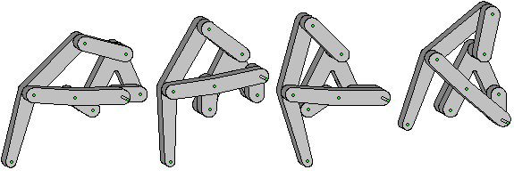
What will we do today?
Learn how to prove!
You see these mechanical linkages:
We will learn to understand how they function in spite of their complexities.
FINISH THE CHAPTER

Slide 19

HOW TO DO PROOFS
FACTS
RULE
WHAT YOU WANT TO PROVE!
LIKE A LAWYER!!!

Slide 20
Homogenous Functions
A function f of two variables x and y defined in a domain D is said to be homogeneous of degree k if, for all (x, y) in D,
f (tx, ty) = t^{k} f (x, y) for all t > 0
Is this function homogenous?
F(K, L) = A(aK^{−e} + bL^{−e})^{−1/e}

Slide 21

Graph
1
2
$$f\left(tx,ty\right)=t^{k}c$$

Slide 22
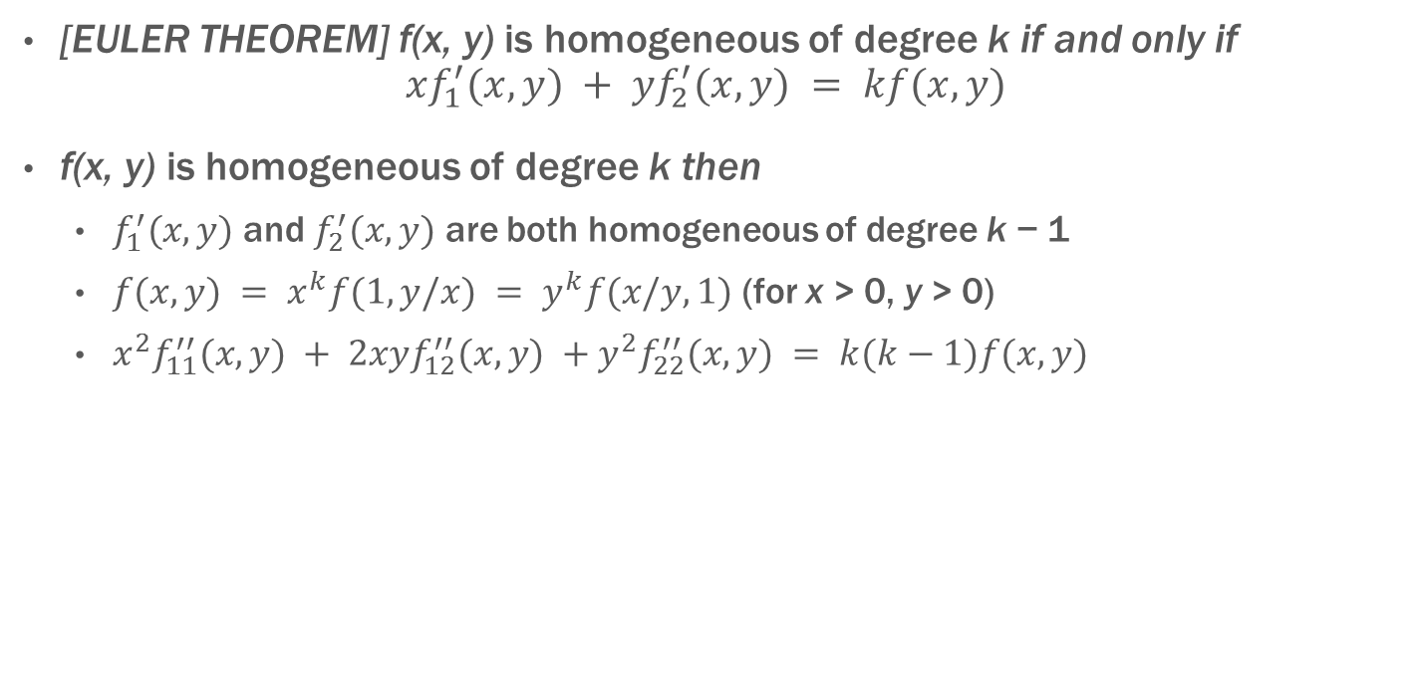
Properties of Homogenous Functions
[EULER THEOREM] f(x, y) is homogeneous of degree k if and only if
$$xf_{1}^{′}(x, y) + yf_{2}^{′}(x, y) = kf(x, y)$$
f(x, y) is homogeneous of degree k then
  $f_{1}^{′}(x, y)$ and $f_{2}^{′}(x, y)$ are both homogeneous of degree k − 1
  $f(x, y) = x^{k}f(1, y/x) = y^{k}f(x/y, 1)$ (for x > 0, y > 0)
  $x^{2}f_{11}^{′′}(x, y) + 2xyf_{12}^{′′}(x, y) +y^{2}f_{22}^{′′}(x, y) = k(k−1)f(x, y)$

Slide 23
Homogenous Function of n variables
A function f of n variables defined in a domain D is said to be homogeneous of degree k if, for all (x₁, x₂, … ,x_{n}) in D,
f(tx₁, tx₂, … ,tx_{n}) = t^{k} f(x₁, x₂, … ,x_{n}) for all t > 0

Slide 24
Homothetic Functions
Let f be a function of n variables x = (x₁, . . . , x_{n}) defined in a cone K. Then f is called homothetic provided that
x, y ∈ K, f (x) = f (y), t > 0 ⇒ f (tx) = f (ty)
H strictly increasing and f is homogeneous of degree k ⇒ F(x) = H(f (x)) is homothetic

Slide 25

Linear Approximations
The linear approximation to f (x, y) about (x₀, y₀) is
$$f \left(x, y\right)≈ f\left(x_{0}, y_{0}\right)+ f_{1}^{′}\left(x_{0}, y_{0}\right)\left(x − x_{0}\right)+f_{2}^{′}\left(x_{0}, y_{0}\right)\left(y − y_{0}\right)$$
What will be the approximation for f which is a function of n variables?

Slide 26
Linear Approximation in Pictures
y = f(x)
y – y₀ = f’(x₀)*(x – x₀)
f‘(x₀)
y₀ = f(x₀)
x₀
x

Slide 27
Midterm Maths Course Review
Check your emails

Slide 28
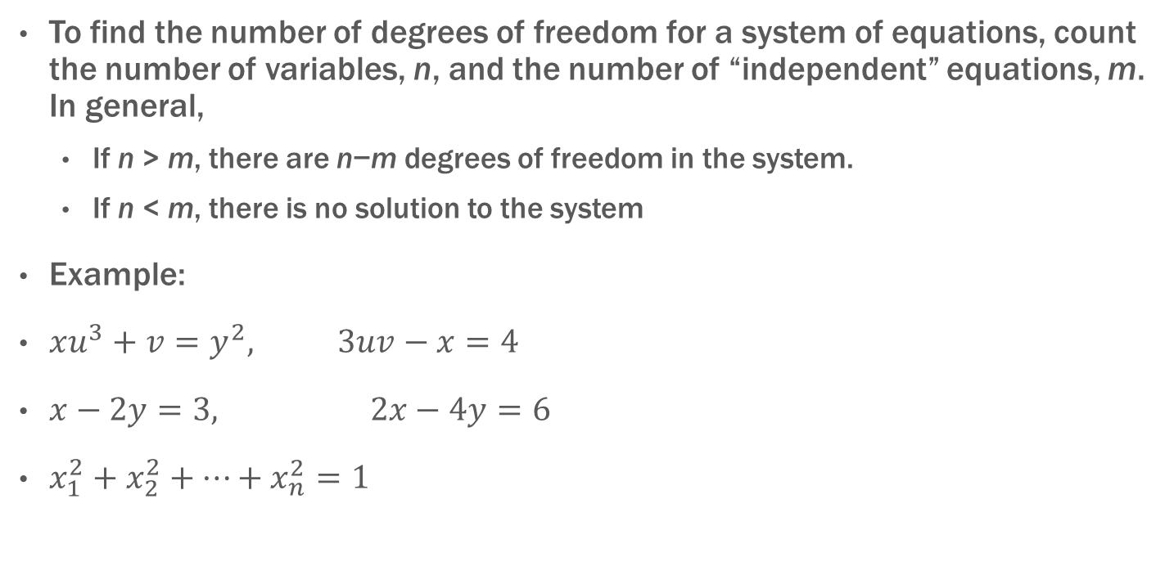
System of Equations
To find the number of degrees of freedom for a system of equations, count the number of variables, n, and the number of “independent” equations, m. In general,
  If n > m, there are n−m degrees of freedom in the system.
  If n < m, there is no solution to the system
Example:
$xu^{3}+v=y^{2}, 3uv−x=4$
$x−2y=3, 2x−4y=6$
$x_{1}^{2}+x_{2}^{2}+…+x_{n}^{2}=1$

Slide 29

Degrees of freedom for a system of equations
A system of equations in n variables is said to have k degrees of freedom if there is a set of k variables that can be freely chosen, while the remaining n−k variables are uniquely determined once the k free variables have been assigned specific values.
How many dof in this system: $xu^{3}+v=y^{2}, 3uv−x=4$

Slide 30
Solve without solving
xu³ + v = y², 3uv − x = 4
Differentiate the system, and solve for du and dv in terms of dx and dy
Find u’_{x} and v’_{x}

Slide 31
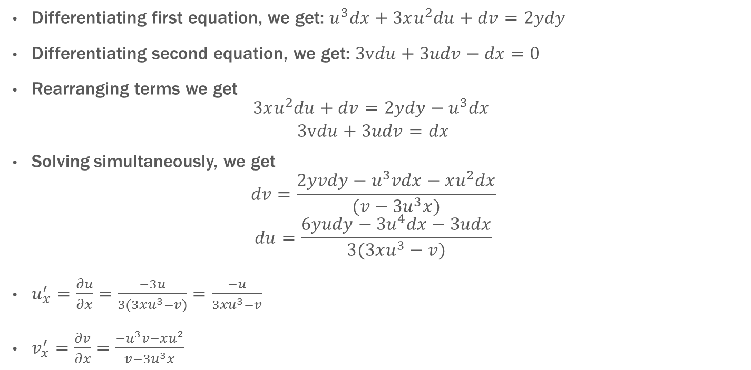
Solution
Differentiating first equation, we get: $u^{3}dx+3xu^{2}du+dv=2ydy$
Differentiating second equation, we get: $3vdu+3udv−dx=0$
Rearranging terms we get
$$\begin{matrix}3xu^{2}du+dv=2ydy−u^{3}dx \\ 3vdu+3udv=dx\end{matrix}$$
Solving simultaneously, we get
$$dv=\frac{2yvdy−u^{3}vdx−xu^{2}dx}{(v−{3u}^{3}x)}$$
$$du=\frac{6yudy−{3u}^{4}dx−3udx}{3(3xu^{3}−v)}$$
$u_{x}^{′}=\frac{∂u}{∂x}=\frac{−3u}{3(3xu^{3}−v)}=\frac{−u}{3xu^{3}−v}$
$v_{x}^{′}=\frac{∂v}{∂x}=\frac{−u^{3}v−xu^{2}}{v−{3u}^{3}x}$

Slide 32
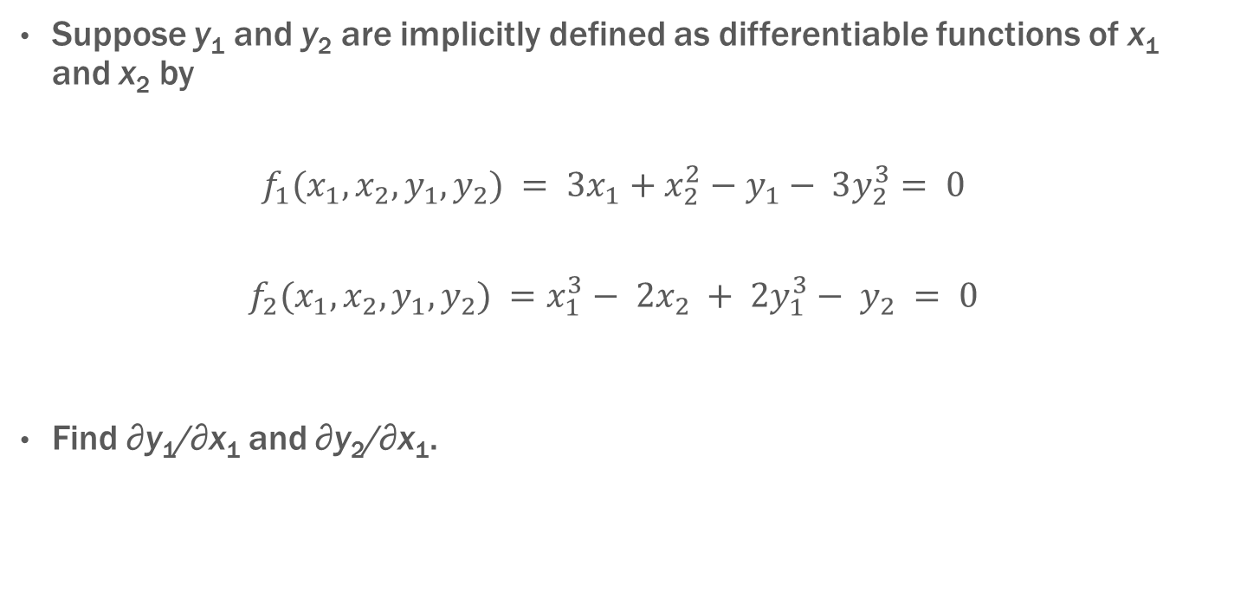
Question
Suppose y₁ and y₂ are implicitly defined as differentiable functions of x₁ and x₂ by
$$f_{1}(x_{1},x_{2},y_{1},y_{2}) = 3x_{1}+x_{2}^{2}−y_{1}− 3y_{2}^{3}= 0$$
$$f_{2}(x_{1},x_{2},y_{1},y_{2}) =x_{1}^{3}− 2x_{2} + 2y_{1}^{3}− y_{2} = 0$$
Find ∂y₁/∂x₁ and ∂y₂/∂x₁.

Slide 33
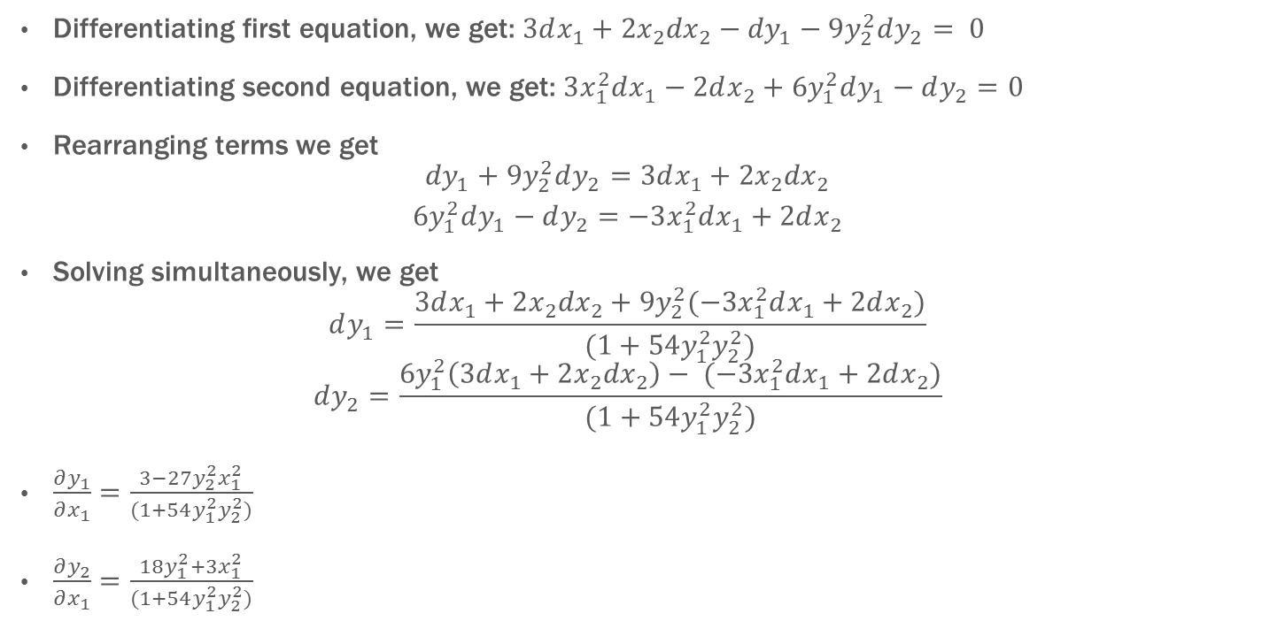
Solution
Differentiating first equation, we get: $3dx_{1}+2{x_{2}dx}_{2}−{dy}_{1}−9y_{2}^{2}dy_{2}= 0$
Differentiating second equation, we get: $3x_{1}^{2}dx_{1}−2dx_{2}+6y_{1}^{2}dy_{1}−dy_{2}=0$
Rearranging terms we get
$$\begin{matrix}{dy}_{1}+9y_{2}^{2}dy_{2}=3dx_{1}+2x_{2}{dx}_{2} \\ 6y_{1}^{2}dy_{1}−dy_{2}=−3x_{1}^{2}dx_{1}+2dx_{2}\end{matrix}$$
Solving simultaneously, we get
$$dy_{1}=\frac{3dx_{1}+2x_{2}{dx}_{2}+9y_{2}^{2}(−3x_{1}^{2}dx_{1}+2dx_{2})}{(1+54y_{1}^{2}y_{2}^{2})}$$
$$dy_{2}=\frac{6y_{1}^{2}\left(3dx_{1}+2x_{2}{dx}_{2}\right)− (−3x_{1}^{2}dx_{1}+2dx_{2})}{(1+54y_{1}^{2}y_{2}^{2})}$$
$\frac{∂y_{1}}{∂x_{1}}=\frac{3−27y_{2}^{2}x_{1}^{2}}{(1+54y_{1}^{2}y_{2}^{2})}$
$\frac{∂y_{2}}{∂x_{1}}=\frac{18y_{1}^{2}+3x_{1}^{2}}{(1+54y_{1}^{2}y_{2}^{2})}$

