Slide 1
Revision Class
Chapters 7 and 8

Slide 2
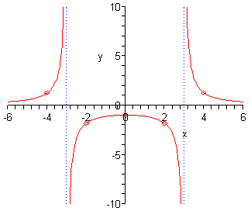
Functions: Maths, Drawing and English
Y depends on x, such that for very small values of x, y is positively sloped function of x. For sufficiently large values of x, y decreases at an increasing rate. For two intermediate values of x, y is not defined. The relationship is inverted u-shaped for all values of x within the stipulated intermediate values of x
$y=\frac{9}{x^{2}−9}$

Slide 3
Key Ideas of the Day
How slopes can be used to say something about the relationship y = f(x)
More importantly, slopes help us find the maximums and the minimums of a function.

Slide 4
Implicit Functions
The relationship between demand for goods (Q) and prices (p) is depicted by this equation
$$\frac{1}{p}Q^{2}−\left(p+1\right)Q=5$$
What is the demand for goods?
I assume $Q≡Q(p)$.
$$\frac{1}{p}Q^{2}(p)−\left(p+1\right)Q(p)=5$$
Calculate dQ/dp to find the slope of the function
$$−\frac{1}{p^{2}}Q^{2}\left(p\right)+\frac{2}{p}Q \left(p\right)Q^{′}\left(p\right)−Q\left(p\right)−\left(p+1\right)Q^{′}\left(p\right)=0$$
$$Q^{′}\left(p\right)=\frac{Q\left(p\right)\text{+ }\frac{1}{p^{2}}Q^{2}\left(p\right)}{\frac{2}{p}Q \left(p\right)−(p+1)}$$

Slide 5

Taylor Formula
$f\left(x\right)=f\left(x_{0}\right)+\frac{1}{1!}f^{′}\left(x_{0}\right)\left(x−x_{0}\right)$
$+\frac{1}{2!}f^{′′}\left(x_{0}\right){\left(x−x_{0}\right)}^{2}+…+\frac{1}{n!}f^{\left(n\right)}\left(x_{0}\right){\left(x−x_{0}\right)}^{n}$
$$+\frac{1}{(n+1)!}f^{(n+1)}\left(c\right){\left(x−x_{0}\right)}^{n+1}$$
where c lies between x₀ and x

Slide 6
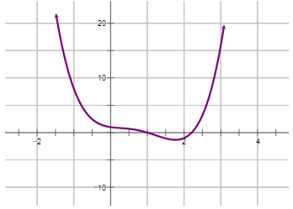
Taylor Formula
x₀

Slide 7
Elasticity
y = f(x)
A 1% change in x produces how much change in y? It is measured by elasticity
$${El}_{x} y=\frac{{dy}/y}{{dx}/x}=\frac{x}{y}.\frac{dy}{dx}=\frac{x}{f(x)}.f′(x)$$
If magnitude of elasticity is greater than 1, the y is elastic
If magnitude of elasticity is less than 1, the y is inelastic
If magnitude of elasticity is 1, the y is unit elastic

Slide 8
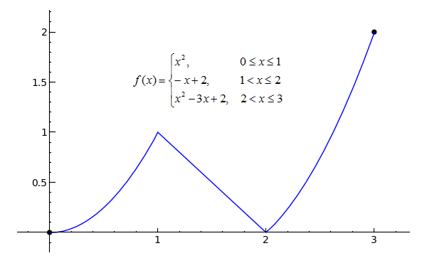
Continuity
No breaks. Graph drawn without lifting pen.

Slide 9
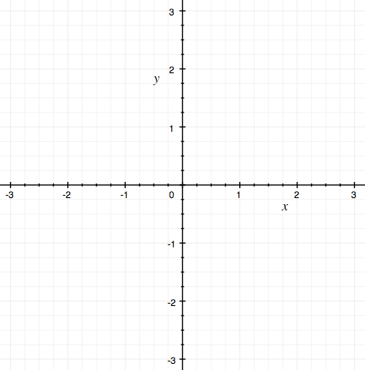
Intermediate Value Theorem – Point 1
f is a continuous function in a closed interval [a, b]
To join two dots above and below the x axis along a continuous function, would involve cutting the x axis at some point c

Slide 10
Intermediate Value Theorem – Point 2
f is a continuous function in a closed interval [a, b]
Pick any level (y value) between the two unequal dots f(a) and f(b). If you jump off from one level, you will land on the curve at a point between a and b. Or, there is an x value (c) corresponding to this y value such that a < c < b and y = f(c)

Slide 11
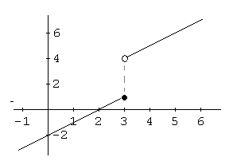
Intermediate Value Theorem – Point 2

Slide 12
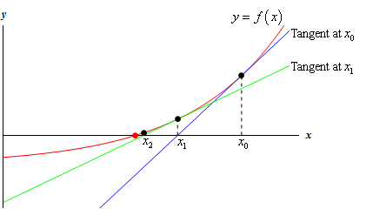
Newton’s Method: how to find x at which f(x) = 0

Slide 13
Extreme Points: Maxima or Minima
f(x) has domain D
c ε D is a maximum point for f if and only if f(x) ≤ f(c) for all x ε D
c ε D is a minimum point for f if and only if f(x) ≥ f(c) for all x ε D

Slide 14
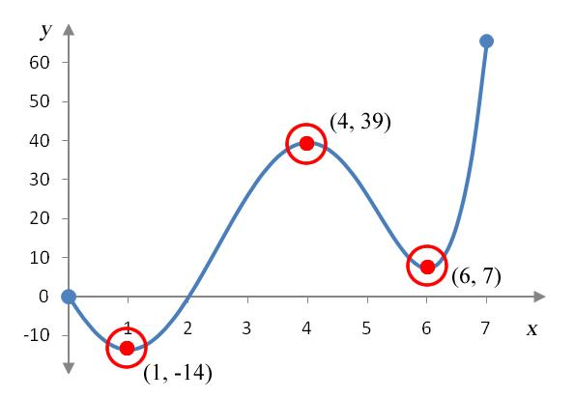
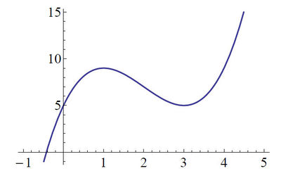
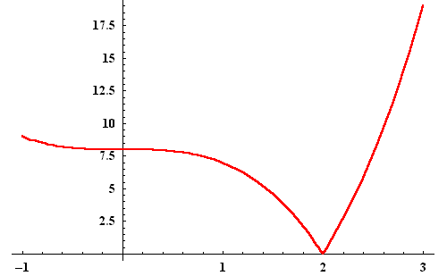
Looking for Extreme Points in Continuous Functions
Boundary values
Differentiable function and Interior values
Not Differentiable function and Interior values
f is a differentiable function and c is an interior point. For c to be an extreme point a necessary condition is that f’(c) = 0

Slide 15
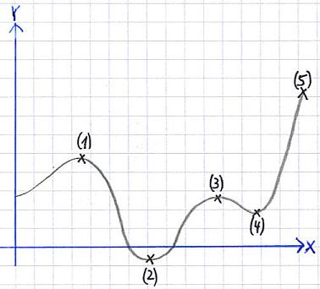
Extreme Points in Continuous Functions
Let us consider a point x = c and the continuous function f(x)
c is a stationary point: f’(c) = 0
Compare the function values of
stationary points and boundary
points
f‘(c) = 0 and f’’(c) < 0 → local maxima
f‘(c) = 0 and f’’(c) > 0 → local minima
f‘(c) = 0 and f’’(c) = 0 → anything

Slide 16
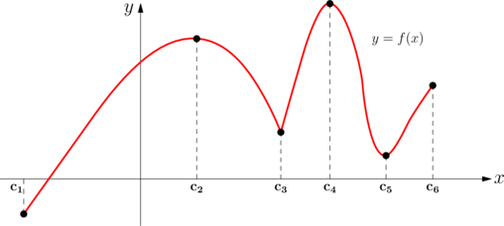
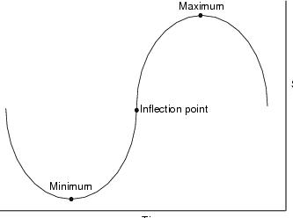
In Continuous Functions

Slide 17
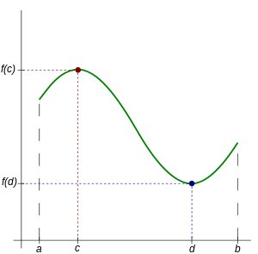
Extreme Value Theorem
Suppose f is a continuous function in a closed and bounded interval [a, b]
There shall exist a maxima (c) and
minima (d)
$f(d)≤f(x)≤f\left(c\right)$ for all x in [a, b]

Slide 18
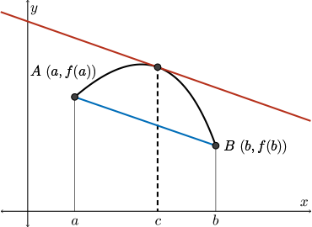
Mean Value Theorem
Suppose f is a continuous function in a closed and bounded interval [a, b] and differentiable in the open interval (a, b)
The average slope between a and b is $s= \frac{f\left(b\right)−f(a)}{b −a}$
You can find at least one interior point c such that f’(c) = s

