Slide 1
Topics in Financial Economics
Chapter 10

Slide 2
What every economics students should know:
Periodic interest rate
Present Value
Continuous Time: Not for exam. Eco and Fin majors read them up
Difference Equations

Slide 3
Interest Rates
Information
Example
Principal: Deposited amount
Interest Period: Time which elapses between successive dates when interest is added to your account
Nominal rate: Announced by banks
Periodic Rate = Annual Nominal Rate / Number of interest periods in a year
P = $8000
T = 5 years
Nominal Rate = 5%
Interest period = 1 month
Periodic Rate = ?
Amount after 5 years = ?

Slide 4
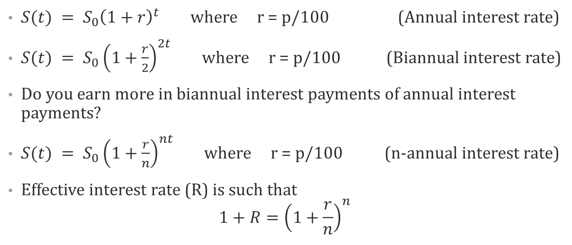
Formula
$S(t) = S_{0}{\left(1+r\right)}^{t}$ where r = p/100 (Annual interest rate)
$S(t) = S_{0}{\left(1+\frac{r}{2}\right)}^{2t}$ where r = p/100 (Biannual interest rate)
Do you earn more in biannual interest payments of annual interest payments?
$S(t) = S_{0}{\left(1+\frac{r}{n}\right)}^{nt}$ where r = p/100 (n-annual interest rate)
Effective interest rate (R) is such that
$$1+R={\left(1+\frac{r}{n}\right)}^{n}$$

Slide 5
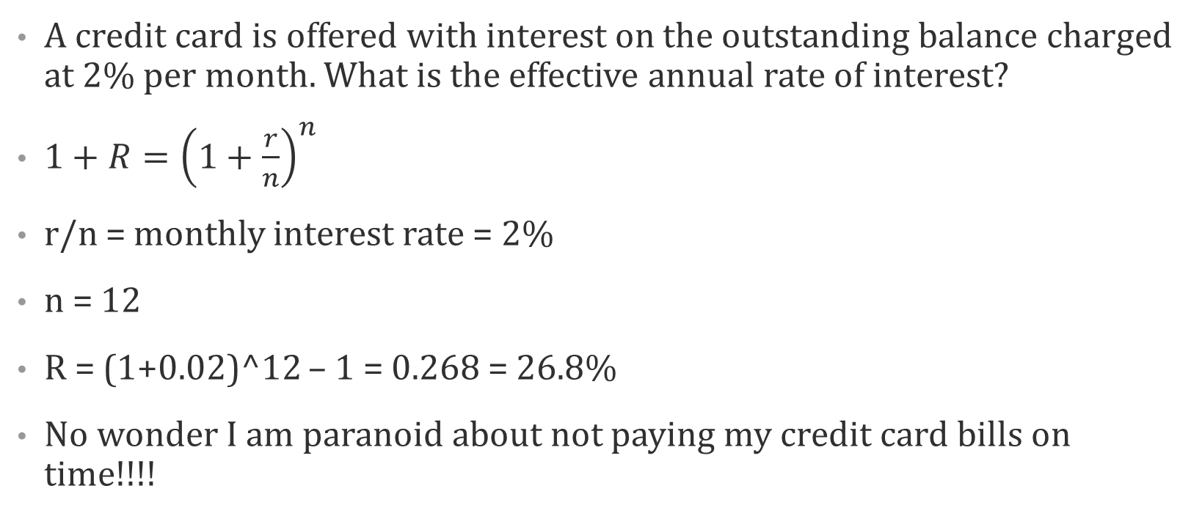
Class Problem - Revised
A credit card is offered with interest on the outstanding balance charged at 2% per month. What is the effective annual rate of interest?
$1+R={\left(1+\frac{r}{n}\right)}^{n}$
r/n = monthly interest rate = 2%
n = 12
R = (1+0.02)^12 – 1 = 0.268 = 26.8%
No wonder I am paranoid about not paying my credit card bills on time!!!!

Slide 6
Present Discounted Value
If the interest or discount rate is p% per year and r = p/100, an amount K that is payable in t years has the present value (or present discounted value, or PDV):
PDV = K(1 + r)^{−t}, with annual interest payments

Slide 7
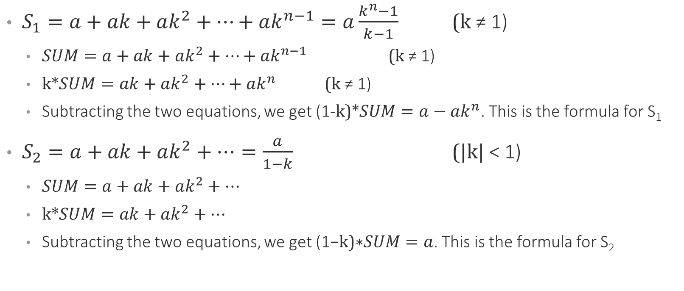
Sidenote on Geometric Series
$S_{1}=a+ak+ak^{2}+…+ak^{n−1}=a\frac{k^{n}−1}{k−1}$ (k ≠ 1)
  $SUM=a+ak+ak^{2}+…+ak^{n−1}$ (k ≠ 1)
  k*$SUM=ak+ak^{2}+…+ak^{n}$ (k ≠ 1)
  Subtracting the two equations, we get $\text{(1−}\text{k}\text{)∗}SUM=a−ak^{n}$. This is the formula for S₁
$S_{2}=a+ak+ak^{2}+…=\frac{a}{1−k}$ (|k| < 1)
  $SUM=a+ak+ak^{2}+…$
  k*$SUM=ak+ak^{2}+…$
  Subtracting the two equations, we get $\text{(1−}\text{k}\text{)∗}SUM=a$. This is the formula for S₂

Slide 8
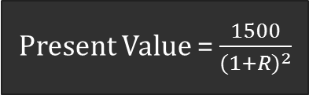
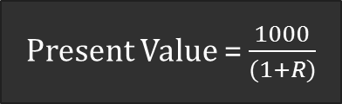
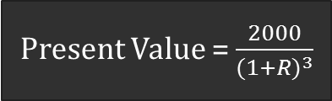
Total Present Value
Make payments
Today
1 year later
Pay Rs. 1000
2 years later
Pay Rs. 1500
3 years later
Pay Rs. 2000
Present Value = $\frac{1000}{(1+R)}$
Present Value = $\frac{1500}{{(1+R)}^{2}}$
Present Value = $\frac{2000}{{(1+R)}^{3}}$

Slide 9
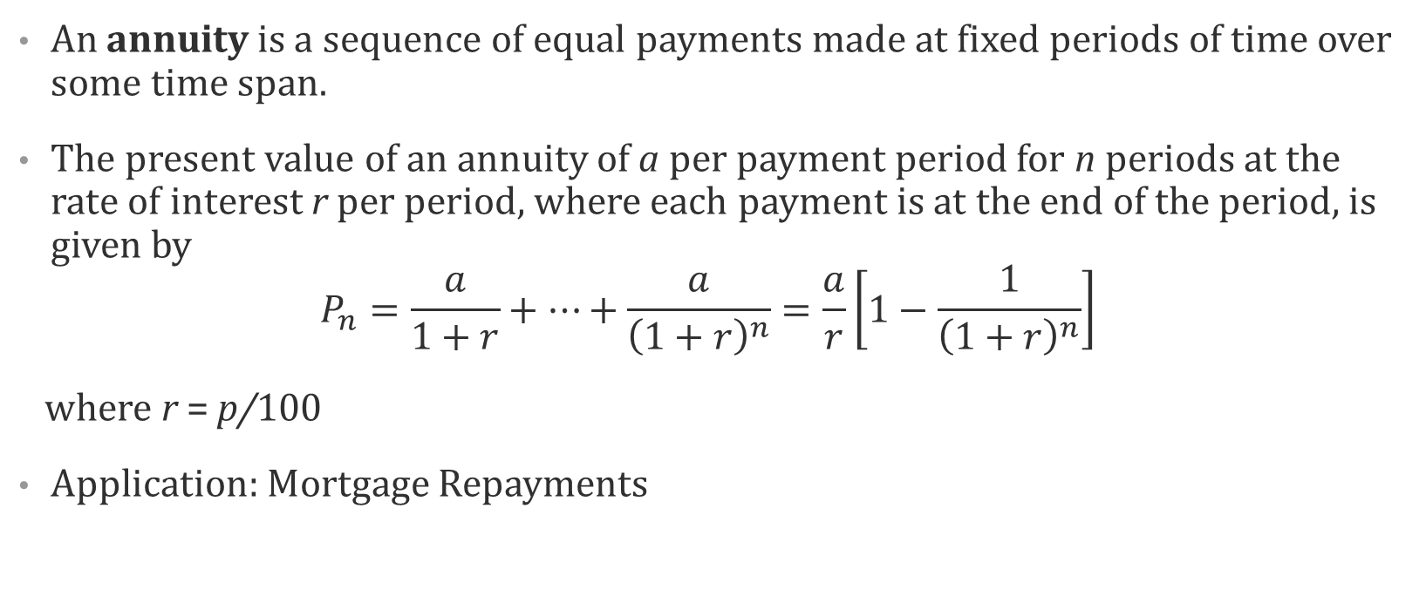
Present Value of Annuity
An annuity is a sequence of equal payments made at fixed periods of time over some time span.
The present value of an annuity of a per payment period for n periods at the
rate of interest r per period, where each payment is at the end of the period, is
given by
$$P_{n}=\frac{a}{1+r}+…+\frac{a}{{\left(1+r\right)}^{n}}=\frac{a}{r}\left[1−\frac{1}{{\left(1+r\right)}^{n}}\right]$$
where r = p/100
Application: Mortgage Repayments

Slide 10
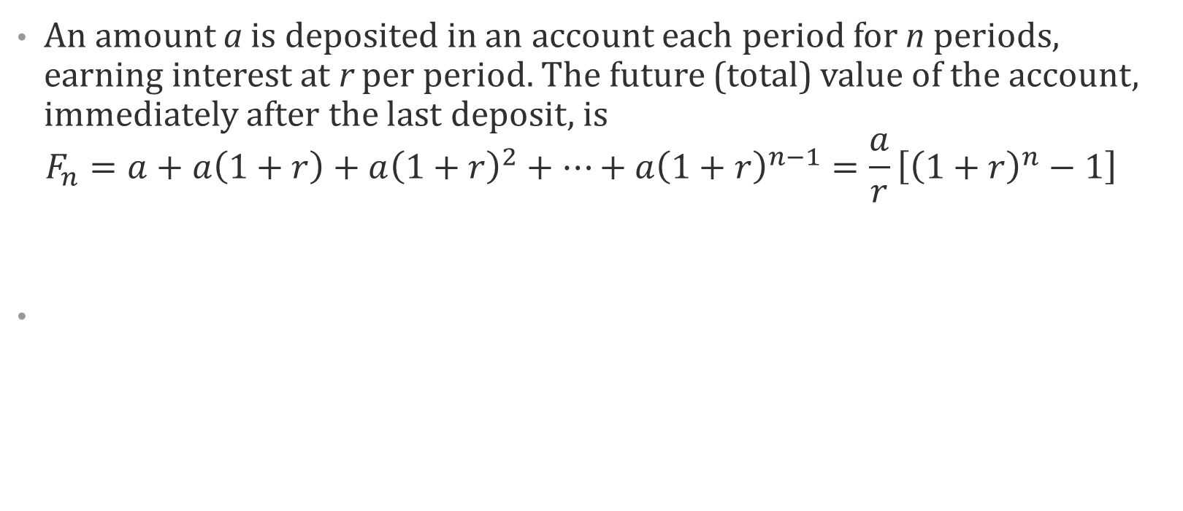
Future Value of Annuity
An amount a is deposited in an account each period for n periods, earning interest at r per period. The future (total) value of the account, immediately after the last deposit, is
$F_{n}=a+a\left(1+r\right)+a{\left(1+r\right)}^{2}+…+a{\left(1+r\right)}^{n−1}=\frac{a}{r}\left[{\left(1+r\right)}^{n}−1\right]$
Money on the nth period
(n-1)th deposit was saved for one period. This is its value in the last period n
(n-2)nd deposit was saved for two periods. This is its value in the last period n
This is the first deposit. It was saved for (n-1) periods.

Slide 11

Difference Equation
$x_{t+1}=ax_{t}$ t = 0, 1, …
$x_{1}=ax_{0}$
$x_{2}=ax_{1}=a∙ax_{0}=a^{2}x_{0}$
$x_{t}=a^{t}x_{0}$

Slide 12

Difference Equation
$x_{t+1}=ax_{t}+b$ t = 0, 1, …, $a≠1$
What is the pattern?
$x_{t}=a^{t}x_{0}+a^{t−1}b+a^{t−2}b+…+b$
  $x_{t}=a^{t}x_{0}+b\left[a^{t−1}+a^{t−2}+…+1\right]$
  $x_{t}=a^{t}x_{0}+b\left[\frac{a^{t}−1}{a−1}\right]$ Geometric Series Formula
  $x_{t}=a^{t}\left(x_{0}−\frac{b}{1−a}\right)+\frac{b}{1−a}$

