Slide 1
Statistics
Anuradha Saha
http://anuradhasaha.weebly.com/statistics.html

Slide 2
Books
Author | Book Name | Edition | Publisher
Sheldon Ross | A First Course in Probability | 9th Edition | Pearson
Irwin Miller, Marylees Miller | John E. Freund's Mathematical Statistics | 8th Edition | Pearson
Gudmund R. Iversen, Mary Gergen | Statistics: The Conceptual Approach | Year of publishing 2011 | Springer
Richard J Larsen and Morris L Marx | An Introduction to Mathematical Statistics and Its Applications | 5th Edition | Pearson
Allen Craig, Robert V. Hogg, Joseph W. McKean | Introduction to Mathematical Statistics | 7th Edition | Pearson
Roxy Peck, Chris Olsen and Jay L. Devore | Introduction to Statistics and Data Analysis | 4th Edition | Cengage Learning
SC Gupta, VK Kapoor | Fundamentals of Applied Statistics (Fundamentals of Mathematical Statistics) | 4th Edition (2014) | Sultan Chand & Sons
About the Course

Slide 3
Course Details
Lecture | Title | Book
1st Week | Backgrounder Topics: Mean, Median, Mode, Percentiles, Variance, Distribution, Graphs and Plots, Symmetry of graphs, Random Variables | Chapters 1 - 4, Iversen and Gergen
2nd Week | Combinatorial Analysis The Basic Principle of Counting, Permutations, Combinations, Binomial Theorem (No Proof), Multinomial Coefficients | Chapter 1, Ross
3rd Week | Probability Sample Space and Events Axioms of Probability Some Simple Propositions (with Proofs) Sample Spaces having Equally Likely Outcomes Probability as a Continuous Set Function | Chapter 2, Ross
About the Course

Slide 4
Other Details
Alternate classes will have take-home assignments
Weekly pop quiz
Out of the Box Grading
Understand -> Apply -> Master
Unpunctuality and sloppiness will not be tolerated
Attendance less than 70% = FAIL
Office Hours: Wednesday (for at least 0.5 hrs)
About the Course

Slide 5
Aim of this Course
Help you understand Statistics
Get you comfortable with Statistical Language
Learn how to evaluate Statistical Results
About the Course

Slide 6
What is Statistics?
Statistics is a set of concepts, rules and methods for
Collecting data
Analyzing data
Drawing conclusions from data
On Statistics

Slide 7
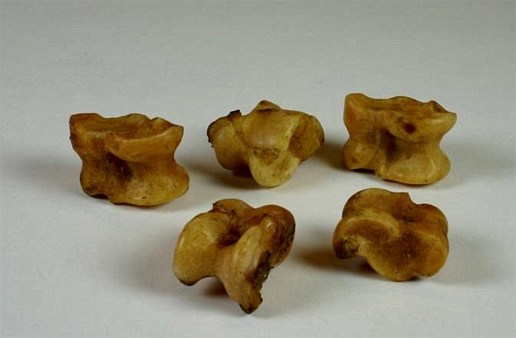
Origin
Ancient world Astragalis
Dice on Egyptian Tombs
Greeks, Romans and Arabs: cards, board games
Study of statistics began in the 16th century.
Why so late?
On Statistics
Notes:
Source of oracle-giri

Slide 8
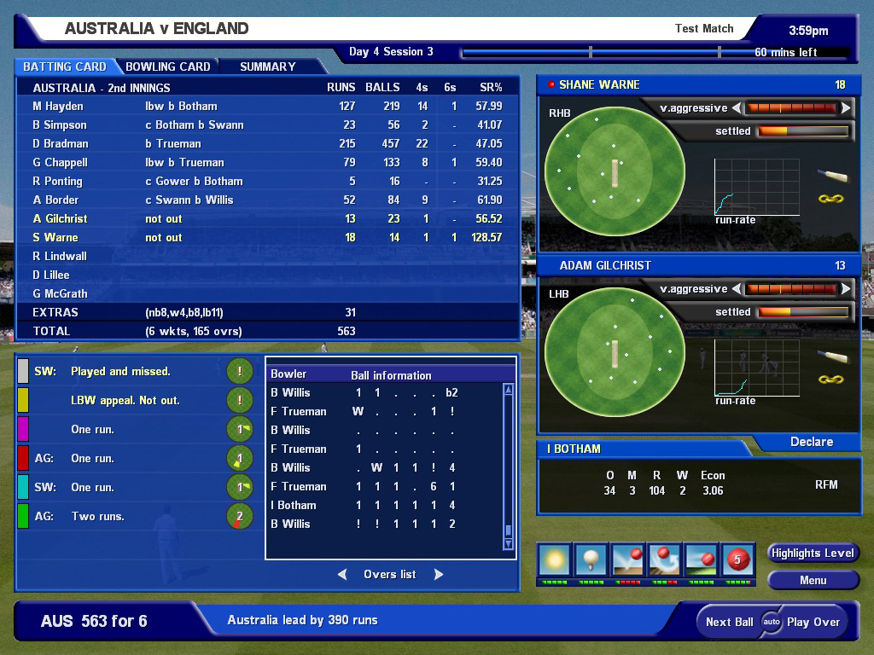
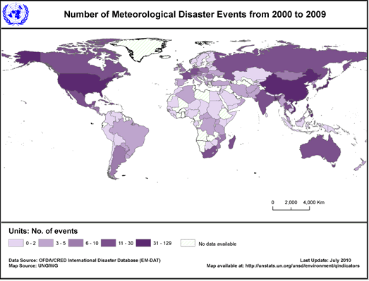
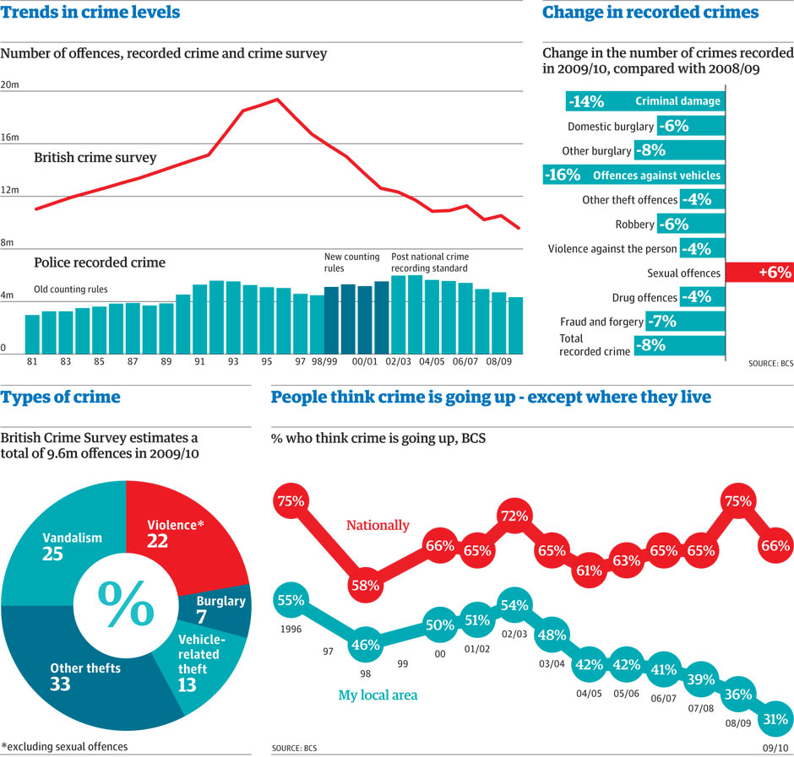
On Statistics

Slide 9
Will you ever need Statistics?
I “bet” you would
Examples:
How to evaluate if Ratul is a better teacher than I am?
“Eat raw yogurt and live to be 100”
Stock market: averages, indicators, trends, exchange rates
Education: standardized testing, Percentiles
Hollywood: who’s watching what, and why
On Statistics

Slide 10
Stats from Zomato Chinese Restaurant in Khan Market.
Restaurant | Mamagato | China Fare | Wok in Clouds | Bombox Café | Taj
Cost for two | 1500 | 1500 | 1500 | 2200 | 4000
Rating | 3.9 | 3.9 | 4.0 | 3.6 | 4.2
Number of Respondents | 906 | 156 | 428 | 1140 | 297
Application

Slide 11
Do you think..
Between Mamagato and China Fare, where would you go?
Why does the number of respondents make you feel uneasy?
Application

Slide 12
Coin Toss Example
Toss a coin, you get H.
Toss it again, you get H.
Can you conclude that the coin has a 100% chance of always showing H?
Whether we take a single new observation or a new set of many observations, most of the time we do not get exactly the same result we did the first time
Data has variance, we study the pattern
Application

Slide 13
Stats from Zomato Chinese Restaurant in Khan Market.
Restaurant | Mamagato | China Fare | Wok in Clouds | Bombox Café | Taj
Cost for two | 1500 | 1500 | 1500 | 2200 | 4000
Rating | 3.9 | 3.9 | 4.0 | 3.6 | 4.2
Number of Respondents | 906 | 156 | 428 | 1140 | 297
Application

Slide 14
Do you think..
Between Taj and China Fare, where would you go?
Are results “forceful or strong”?
Are results sensitive to sample characteristics?
Application

Slide 15
Literary Digest Example
Before Roosevelt’s second term in 1936, survey conducted on “Who will win Landon or Roosevelt?”
Sample ballots sent to people listed in telephone directory and car registry
10 million sent out, not so many received
Reply: Landon favourite
Egg on the face
Application

Slide 16
So which restaurant to go?
Restaurant | Mamagato | China Fare | Wok in Clouds | Bombox Café | Taj
Cost for two | 1500 | 1500 | 1500 | 2200 | 4000
Rating | 3.9 | 3.9 | 4.0 | 3.6 | 4.2
Number of Respondents | 906 | 156 | 428 | 1140 | 297
Application

Slide 17
Is there something fishy?
Early diagnosis of cancer leads to longer survival times, so screening programmes are beneficial
The displayed price has been discounted 25% for eligible customers, but you are not eligible so you have to pay 25% more than the displayed price
Life expectancy will reach 150 years in the next century based on simple extrapolation from increase in the past century
Every year since 1950, number of American children gunned down has doubled
Application

Slide 18
So far…
We realize Statistics is an important subject
We realize that foolish Statisticians are a menace
We have to be smart Statisticians, not merely students of Statistics!
What are the tools for Statisticians?
Application

Slide 19
The Road Ahead
Data Collection
Data Overview
Probabilities of Outcomes
Distribution
Drawing Conclusions
Relationship between Variables
Correlations and Causality
Overview

Slide 20
Data – The Raw Materials
Values
Variable Name
Overview

Slide 21
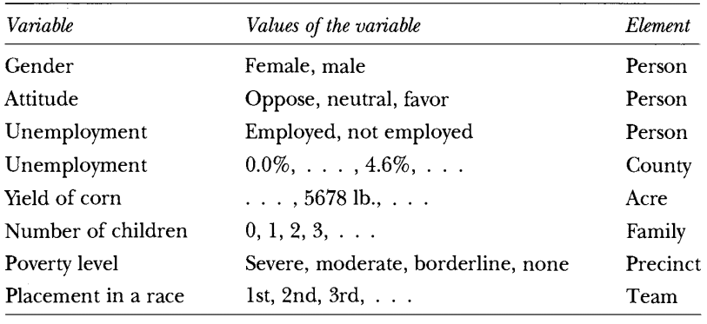
Variables, Values and Elements
Value of a variable is a measure of a specific unity, often thought of as an element
Overview

Slide 22
Data Collection
Data Collection

Slide 23
Key Points
Well defined variable
Observation Data
Select a well-stirred sample
Errors in sample properties, response rate, questionnaire (wording, placement), interviewers
Experimental Data
Good Experimental and Control Groups
Experimental Design
Data Collection

Slide 24
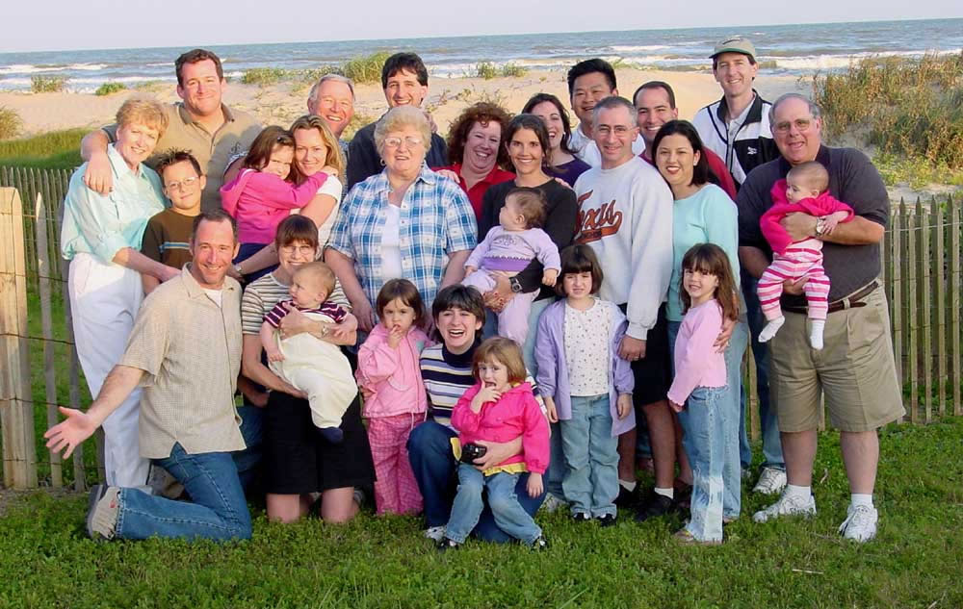
How many children are in this family?
Define “children in family”: child under 18 years of age living with his or her biological parents
Data Collection

Slide 25
Observational Data
Data collected from the observation of the world without manipulating or controlling it
National Statistics, Firm level Statistics
Population: all elements under study
Census: process of collecting data on the entire population
Sample: selected part of population
Data Collection

Slide 26
Well Framed Question
Identify variables needed
“Research indicates that men tend to vote for BJP while women tend to vote for Congress”
Is it because of Y chromosome?
Is it perception of women about Congress is more “women friendly”?
Is it because women are poor and Congress has more pro-poor policies?
Data Collection

Slide 27
Well Stirred Sample
Random Sample: Sample drawn from a population in which every element has a known chance of being included in the sample
Literary Digest Example.
Gender-Politics: Income-Gender balance
Sample of students in Ashoka collected in women’s residence
Sample of students in Ashoka collected on cricket ground
Data Collection

Slide 28
Errors
Sampling error: Sample did not match the attributes of the population. Larger the sample, smaller is the sampling error
Non response error: unwillingness to respond, inability to locate respondent. Ensure that non respondents are not very different from the respondents
Questionnaire: Man goes for women’s health survey. Religiously attired person goes to a secularism survey
Data Collection
Notes:
“Does it seem possible or does it seem impossible to you that the Nazi extermination of the Jews never happened?” Confusing.
“Does it seem possible to you that the Nazi extermination of the Jews never happened, or do you feel certain that it happened?”

Slide 29
Experimental Data
Data collected on variables resulting from the manipulation of subjects in experiments
Animal testing, Medical evaluation studies
Two groups: Control and Experimental
Control Group: Randomly selected subsets of the subjects in an experiment that is not manipulated
Experimental Group: The manipulated lot
Data Collection

Slide 30
Scurvy Experiment
In 1600s British wanted to find the cause of scurvy – swollen bleeding gums which often attacked sailors on long journeys.
Hypothesis: Lack of citrus fruits causes diseases
Experiment: 4 ships – 1 with citrus fruits, 3 without
Result: the citrus-less ships sailors got so sick that they had to be periodically transferred to the first ship
Any problem in the experiment?
Data Collection

Slide 31
Issues with Experiments
Logistics: how to motivate people to act as good guinea pigs
Psychological: Hawthrone effect
Ethical: PETA
Experiments require intense planning
How many observations?
More tricky to study the effect of several variables at the same time
Data Collection

Slide 32
Data Presentation
A gain in simplicity involves a loss of information, a good statistician can strike a right balance
Lots of Examples
Data Presentation

Slide 33
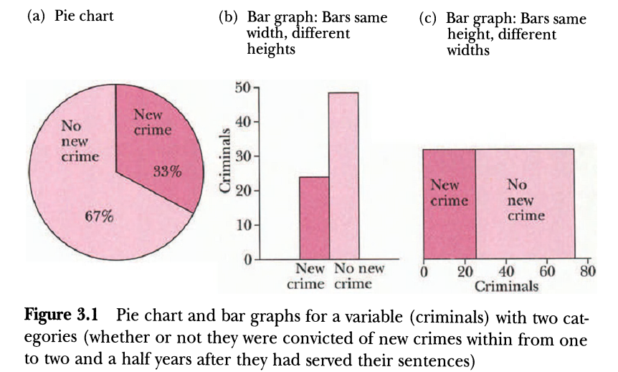
One Category Variable
Variable with two observations, which can not be ranked.
Data Presentation

Slide 34
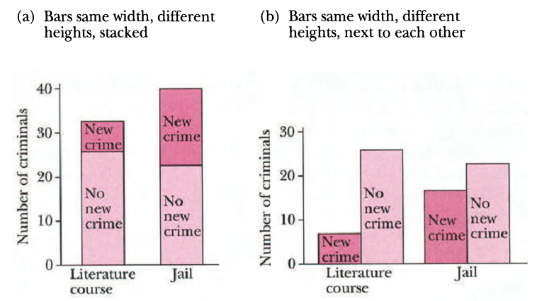
Two Category Variable
Data Presentation

Slide 35
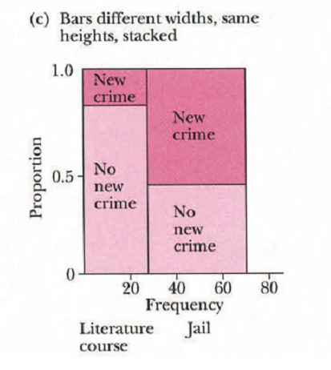
Two Category Variable
Data Presentation

Slide 36
Example 1
“Ideally how far from home would you like the college you attend to be?”
 | Frequency |  | Relative Frequency
Ideal Distance | Students | Parents | Students | Parents
Less than 250 miles | 4450 | 1594 | 0.35 | 0.53
250 to 500 miles | 3942 | 902 | 0.31 | 0.3
500 to 1000 miles | 2416 | 331 | 0.19 | 0.11
Total | 12715 | 3007 | 1 | 1
Data Presentation

Slide 37
Example 1
Data Presentation

Slide 38
Example 1
Data Presentation

Slide 39
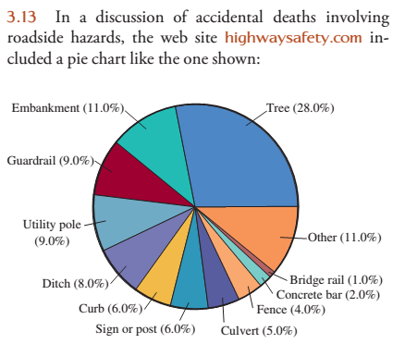
Exercise 1

Slide 40
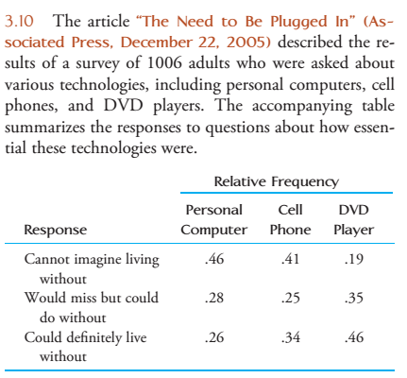
Exercise 2

Slide 43
Metric Variable
We can compare the observations.
Age of women who applied for marriage license:
30 27 56 40 30 26 …..
Data Presentation

Slide 44
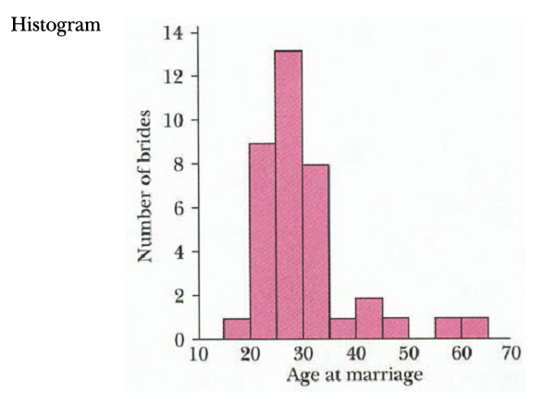
Metric Variable
Data Presentation

Slide 45
Metric Variable
Data Presentation

Slide 46
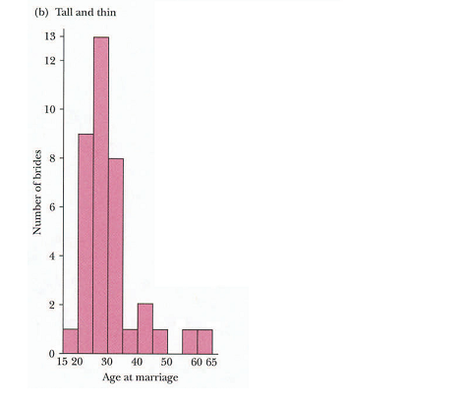
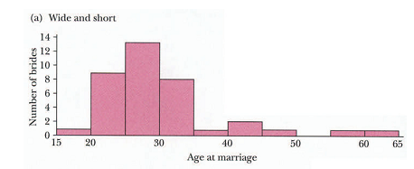
Metric Variable
Data Presentation

Slide 47
Example 2
The National Center for Education Statistics provided the accompanying data on this percentage of college students enrolled in public institutions for the 50 U.S. states for fall 2007.
96 86 81 84 77 90 73 53 90 96 73 93 76 86 78 76 88 86 87 64 60 58 89 86 80 66 70 90 89 82 73 81 73 72 56 55 75 77 82 83 79 75 59 59 43 50 64 80 82 75
Data Presentation

Slide 48
Example 2
Class Interval | Frequency | Relative Frequency
40 to < 50 | 1 | 0.02
50 to < 60 | 7 | 0.14
60 to < 70 | 4 | 0.08
70 to < 80 | 15 | 0.3
80 to < 90 | 17 | 0.34
90 to < 100 | 6 | 0.12
Total | 50 | 1
Data Presentation

Slide 49
Example 2
Data Presentation

Slide 50
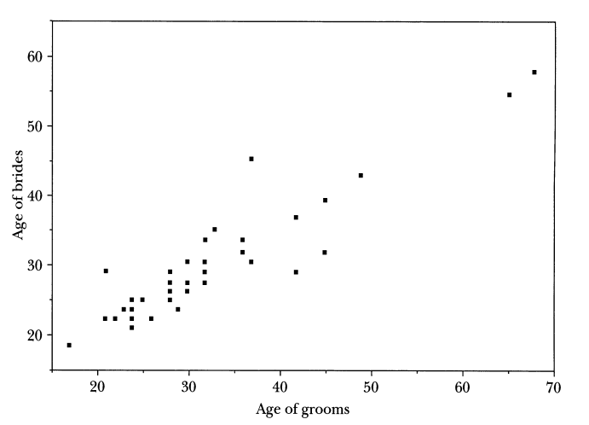
Two Metric Variables
Data Presentation

Slide 51
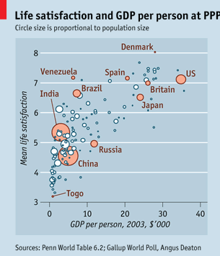
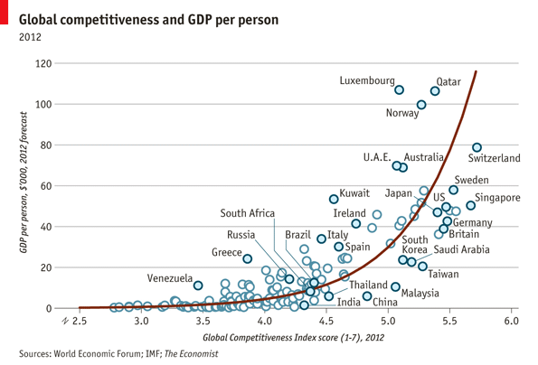
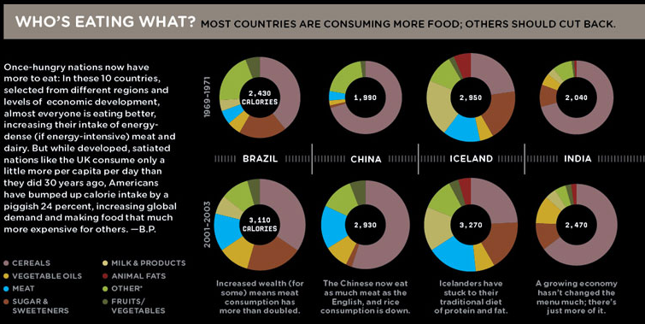
Fancy Plots
Data Presentation

Slide 52
Summary Statistics of a Variable
Mode: Value of variable that occurs the most
Median (50th Percentile): Value of variable that divides all observations into two equal groups
Mean: Sum of values divided by the number of their observations
What do the different statistics mean?
Summary Statistics

Slide 53
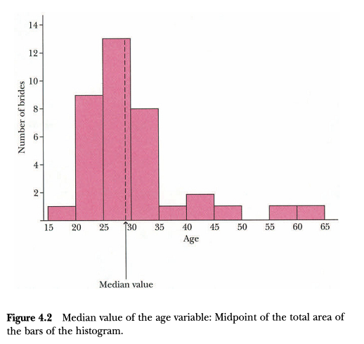
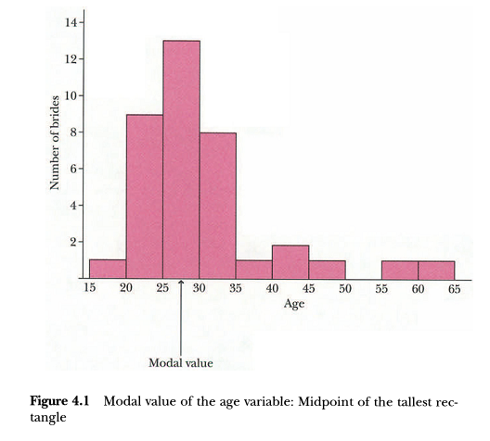
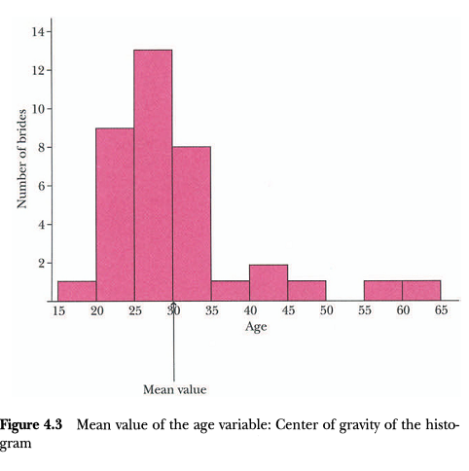
Summary Statistics of a Variable
Summary Statistics

Slide 54
Summary Statistics of a Variable
Range: Difference between largest and smallest observation values
Standard Deviation: Average distance from the mean
Variance: Square of standard deviation!
Standard Error: Standard deviation of means from many different samples
Standard Score: Value of observation minus the mean, and this difference is divided by standard deviation
Summary Statistics

Slide 55
Summary Statistics of a Variable
Lower Quartile (Q1): 25th percentile of data. It can be interpreted as the median of the lower half of the sample
Upper Quartile (Q3): 75th percentile of data. It is also the median of the upper half of the sample
(If n is odd, the median of the entire sample is excluded from both halves when computing quartiles.)
Interquartile range (IQR): It is a measure of variability. It is not as sensitive to the presence of outliers (values very different from the mean) as the standard deviation. IQR = Q3 – Q1
Semi Interquartile range: IQR/2
Mid Quartile: (Q1 + Q3)/2
Summary Statistics

Slide 56
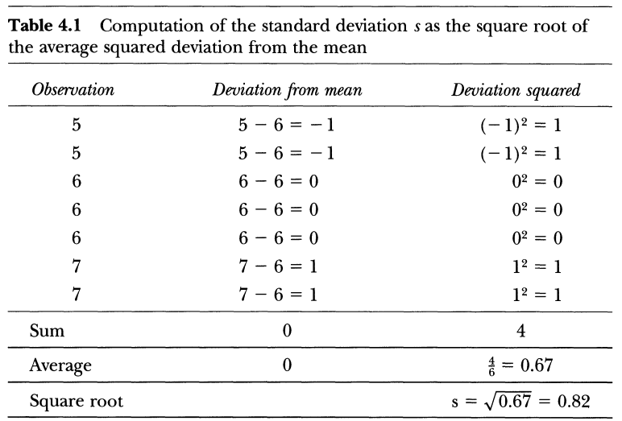
Example
Summary Statistics

Slide 57
Example
Standard Error: s/√n. (0.82/ √ 7)
Standard score: (x - x̄)/s
Summary Statistics

Slide 58
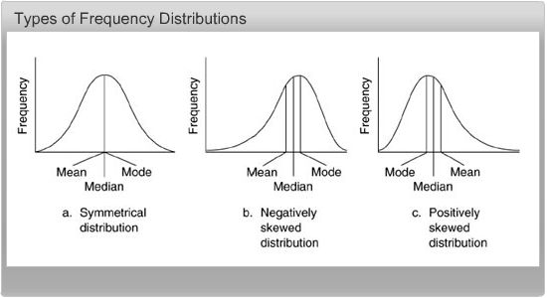
Add Ons
Summary Statistics

